Slide 1

131st Annual Meeting
April 30, 2025

Slide 2
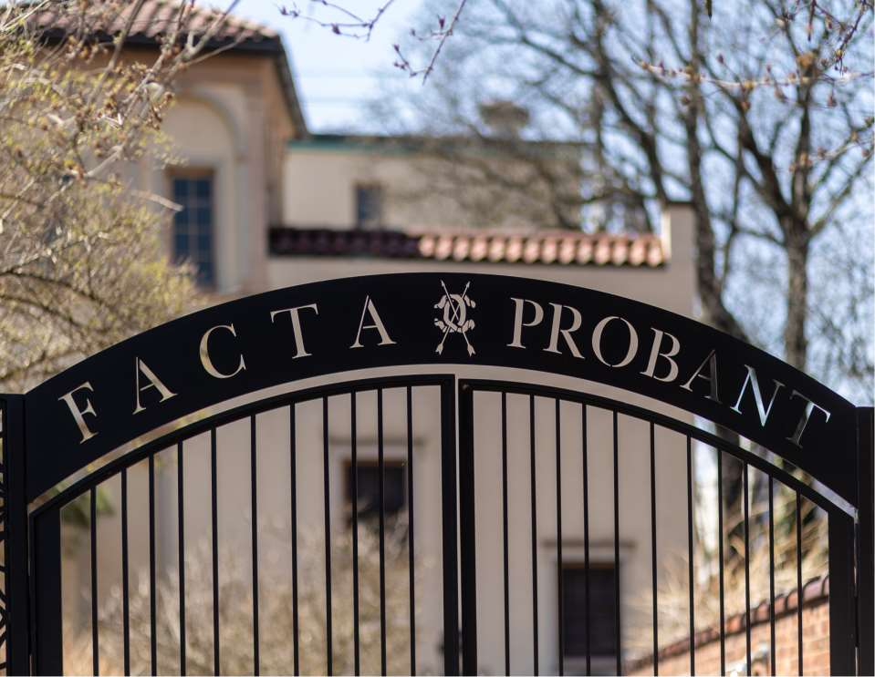

Slide 3
Meeting Agenda
•Welcome and Call to Order
Kathy Schwinger – President
• • • • •
Committee Reports Bylaw Votes Nominating Committee 2024-2025 Highlights Closing Remarks
Kathy Schwinger – President

Slide 4
A Call to Order by
President Kathy Schwinger
Board Secretary, Mitzie Serafin, will be taking minutes.
Roz Annunziato is Parliamentarian.
Madam Secretary – do we have a quorum?
Minutes from the April 26, 2024 Annual Meeting
were approved by the 2024 - 2025 Board.
I appoint the 2025 - 2026 Board to approve the
Minutes of this meeting.

Slide 5
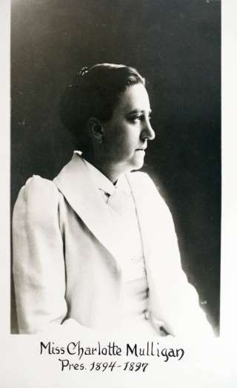
We pause for a
moment of silence,
And remember those
who have
Come before us,
including our foundress,
Miss Charlotte Mulligan

Slide 6

In Memoriam
Deborah Billoni
August 22, 2024
Andrea Borgioli
October 27, 2024
Constance Hadala
December 19, 2024

Slide 7
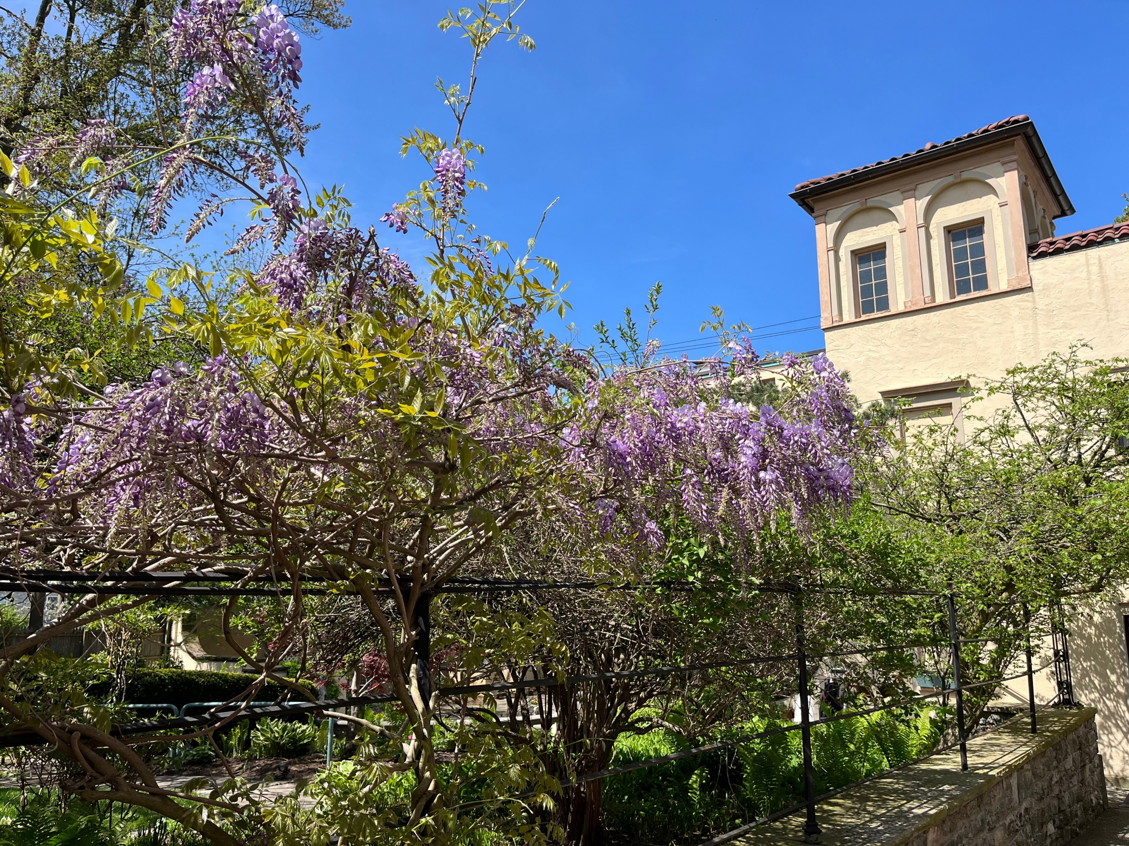

Slide 8
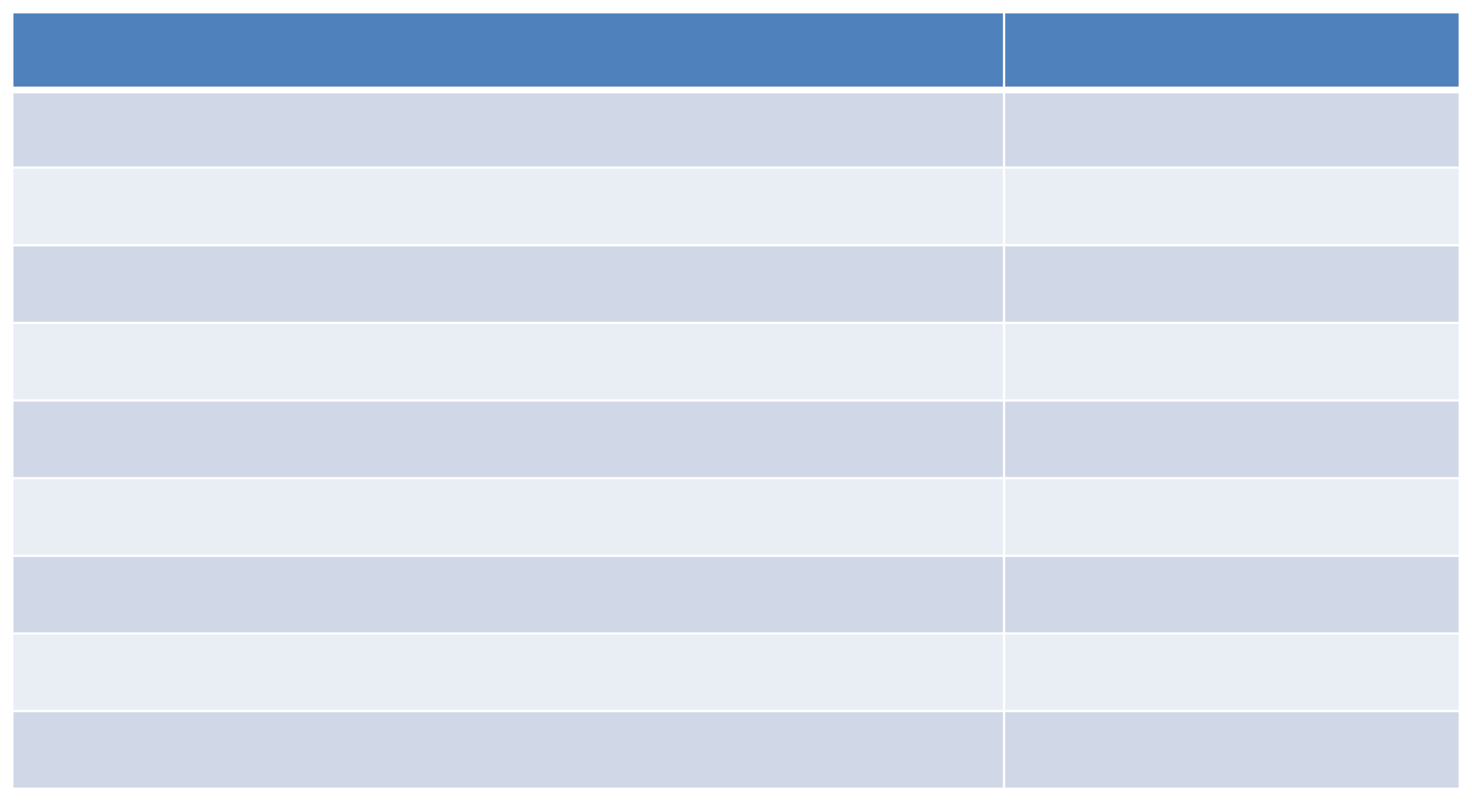
Treasurer’s Report
Janet Bevilacqua
As of March 31, 2025
TOTAL CASH
$429,349
TOTAL CURRENT ASSETS
$625,655
CURRENT LIABILITIES
$192,452
WORKING CAPITAL
$433,203

Slide 9
Finance Report –Ann Demopoulos
Thank you to the Finance Committee: Chris-Elaine Santilli, Vice Chair;
Janet Bevilaqua, Treasurer; Elizabeth Hulley, Assistant Treasurer; Kathleen
Schwinger, President; Susan Grelick, President Elect; Tish Brady, Programs;
Diane Burkholder, At Large; Mitzie Serafin, Recording Secretary; Barbara
Arnold, Personnel and Erin Sullivan.
Monthly review of budget versus actual expenditures
Monitored delinquent accounts and assisted with collection
Made recommendations to the Board to remove members for
non-payment of dues
Worked with accounting firm for annual financial statements and tax returns
Our CPA Firm (Chiampou Travis) presented drafts of the financials and
the tax return in September.
Worked with Club Manager to create the budget for 2025– 2026.

Slide 10
Finance Report –Ann Demopoulos
Through 03/ 31/2025
2025
2024
2023
$1,028,980
$1,035,759
$916,377
Income $
Expenses $
$1,063,988
$1,098,210
$986,047
Net Income $ $(34,987)
$(62,451)
$26,330

Slide 11
Finance Report –Ann Demopoulos
How is the Club doing financially?
The Club has a negative balance
for the second year in a row.
Do members have access to the financial reports?
Minutes from the Board and the Finance Committee meetings, monthly
financial statements, and Treasurer’s Reports are available in Ms. Sullivan's
office for several months and then are retained in Archives.

Slide 12
Finance Report –Ann Demopoulos
What are our dues being used for?
Our dues continue to be used to keep the Club functioning. Our dues must cover payroll, insurances, property tax, and utilities. The cost of each of these components has INCREASED for each this year.
What is the staffing situation?
The Club has not yet achieved full staff levels.
Hourly wages continue to increase and the availability of employees is lagging.

Slide 13

Finance Report –Ann Demopoulos
WHAT YOUR MEMBERSHIP DUES MUST COVER
PAYROLL
INSURANCE
PROPERTY
UTILITIES
TAX
$28,500
$574,160
$68,155
$40,940

Slide 14
Finance Report
Ann Demopoulos
As a tax-exempt social club, the Club must meet certain thresholds related to its non-member revenue:
  No more than 35% of the Club’s revenue can be from non-member sources (events and investment income)
  Of that 35%, no more than 15% can be from
  non-member events

Slide 15
Finance Report
Ann Demopoulos
WE NEED YOU!!
Come to the Wednesday program & lunch!
Come to the daytime or evening events!
Plan a luncheon, dinner, or event at the Club with colleagues, friends, or family!
The more you use the Club, the better and stronger the Club becomes!

Slide 16
MEMBERSHIP – CANDY BROMAN
Members of the Committee: co-chair Joyce Barbalato, Barbara Burwick, Cecilia Chella, Sue Dempsey, Jennifer Dowdell, Linda Gianturco, Jane Hartney, Kathie Homer, Toni Louden, Isabelle Posner, Soledad Proano, Anne Slater, Cheryl Whitehead, Janice Worobec and Kathy Schwinger
Meets monthly to review all applications, requests for leaves of absence, class changes and resignations and makes recommendations for action by the Board of Directors
Hosts a weekly Wednesday Membership Table for prospective members
Holds a prospective member open house as well as orientations for new members
Reviews and makes recommendations to the Board of Directors concerning membership issues
Interviews new members for Wednesday introductions and newsletter articles
Conducts exit interviews with resigning members
Explores ways to recruit new members and retain current members
Contacts and follows up with information with women interested in membership from tours, our web site, and members

Slide 17
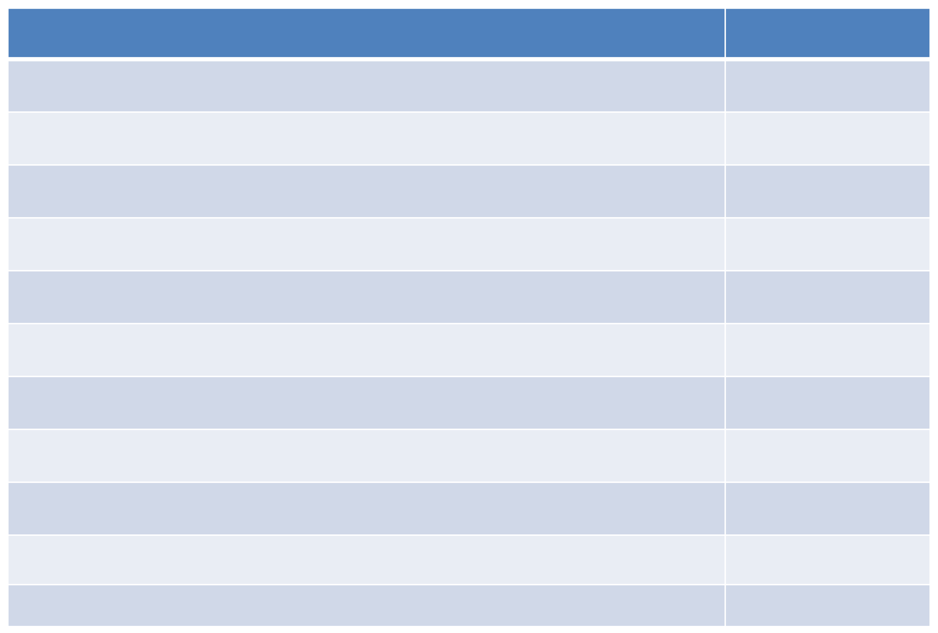
Member Profile
May 1, 2024 –April 24, 2025
MEMBERSHIP CLASSES
Class A -Resident Class A+-Resident 30+ years
Class B-Non-Resident Class C -Professional Class C+ -Professional 30+ years
Class D -Honorary
Class E-Junior
Life Member
Social Member
TOTAL
118
3
8
2
1
5
7
1
2
169
TOTAL

Slide 18
Member Profile
May 1, 2024 –April 24, 2025
NEW MEMBERS | 18
Class Change | 6
Return from leave | 3
Reinstatement | 1
Leave of Absence | 9
Deaths | 2
Resignations | 20

Slide 19
General Programs – Tish Brady
May 2024 – April 2025
Wednesday Programs – 35
Total Attendance - 2925

Slide 20
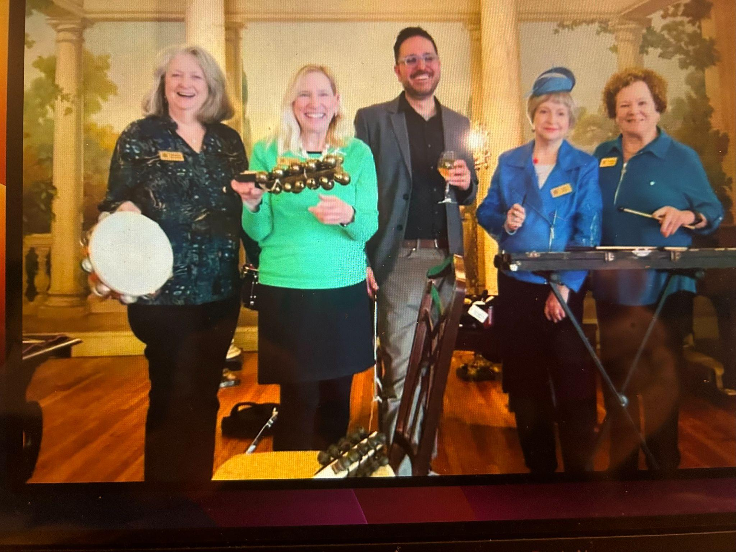
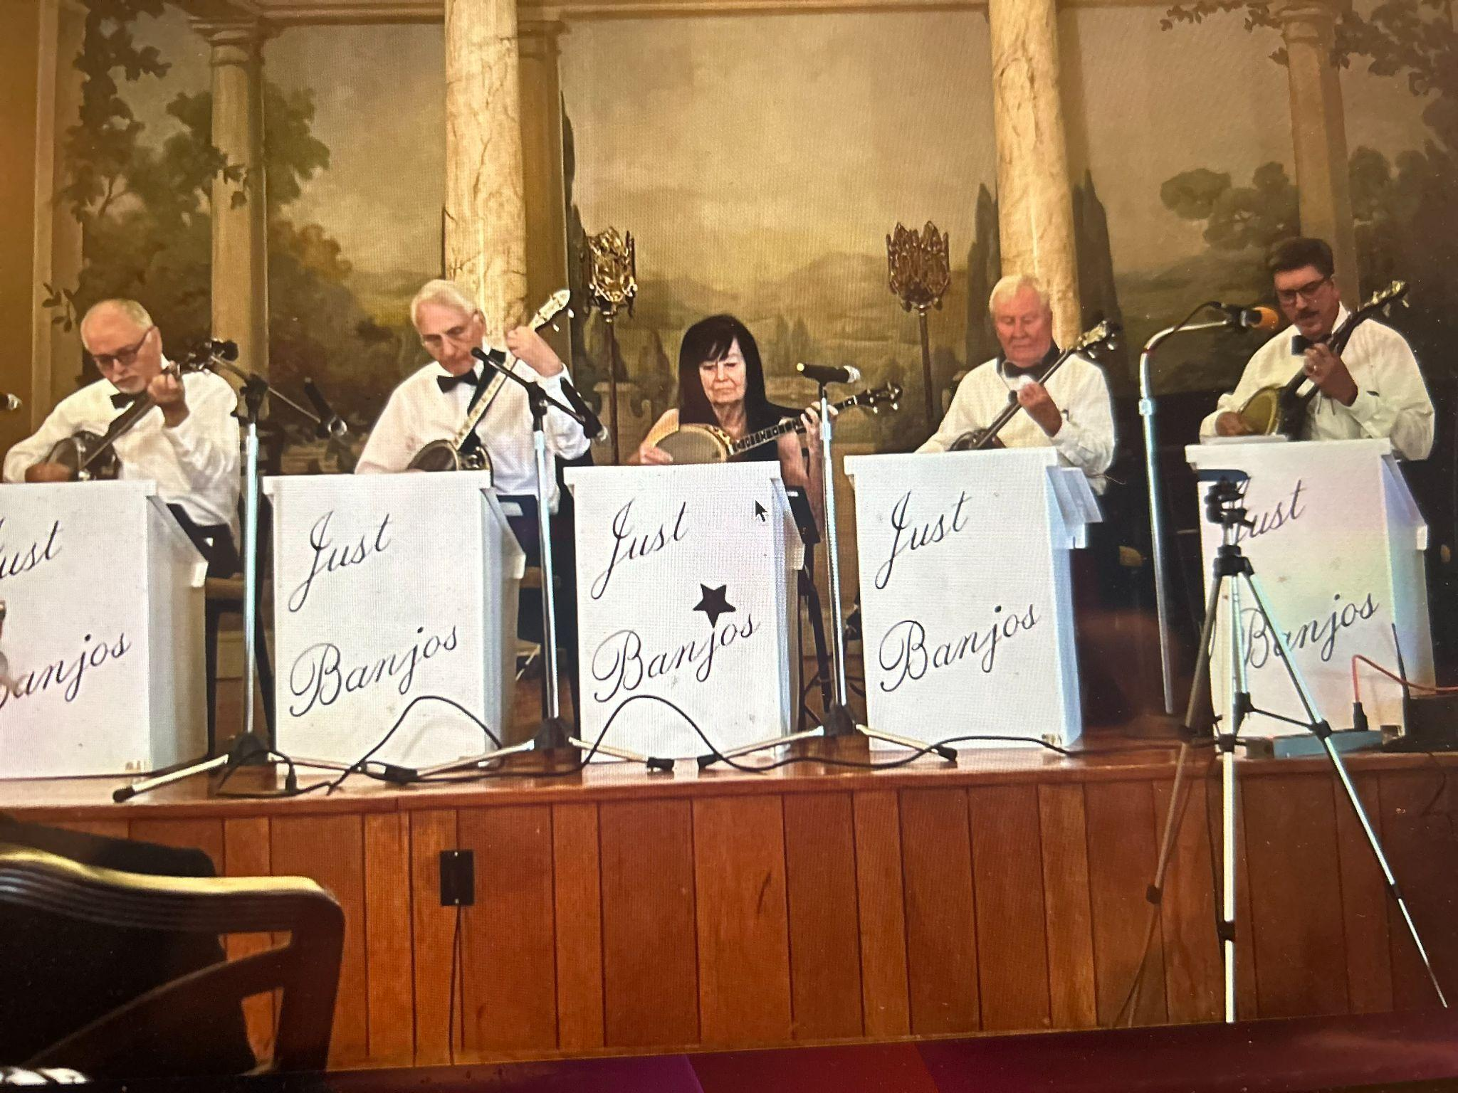

Slide 21
General Programs
Wednesday Program Committees
 | Chairs/Co-Chairs | Programs | Members
Art | Chair Barbara Nelson Co-Chair Kathie Homer | 8 | 792
Music | Chair Jean Jain Co-Chair Anne Moot | 5 | 458
Sciences/Health Sciences | Chair Isabelle Posner Co-Chair Ellen Keable | 4 | 269
Free Lance | Chair Ann Marie Ervolina | 5 | 449
Public Affairs | Chair Marcia Myszka Co-Chair Toni Louden | 4 | 347
Literary | Chair Ann Slater Co-Chair Barb Nagowski | 4 | 356
Library | Chair Barb Kaye | 1 | 92
Annual Sports Program | Chair Susan Grelick Co-Chair Mitzie Serafin | 1 | 74
Summer Program | Chair Lynne Lowery Co-Chair Jane Hartney | 8 | 688

Slide 22
Enrichment Committees
General Programs
Birthdays and Posters Chair Fay Northrup
Charlottes Shop Chair Janice Worobec
Coffee Hour Chair Barb Bielecki
Co-Chair Barb Nagowski
Docents Chair Chris Elaine Santilli
Greeters Chair Barb Utter
Co-Chair Cynthia Raven
Historian Chair Kathie Homer
Co-Chair Toni Louden
Holiday Decor Chair Linda Gianturco
Co-Chair Karen DiVito
Hostesses Presidents Table
Chair Diane Christman
New Member Orientation Chair
Kathie Homer
Photographer Chair Kathie Homer

Slide 23
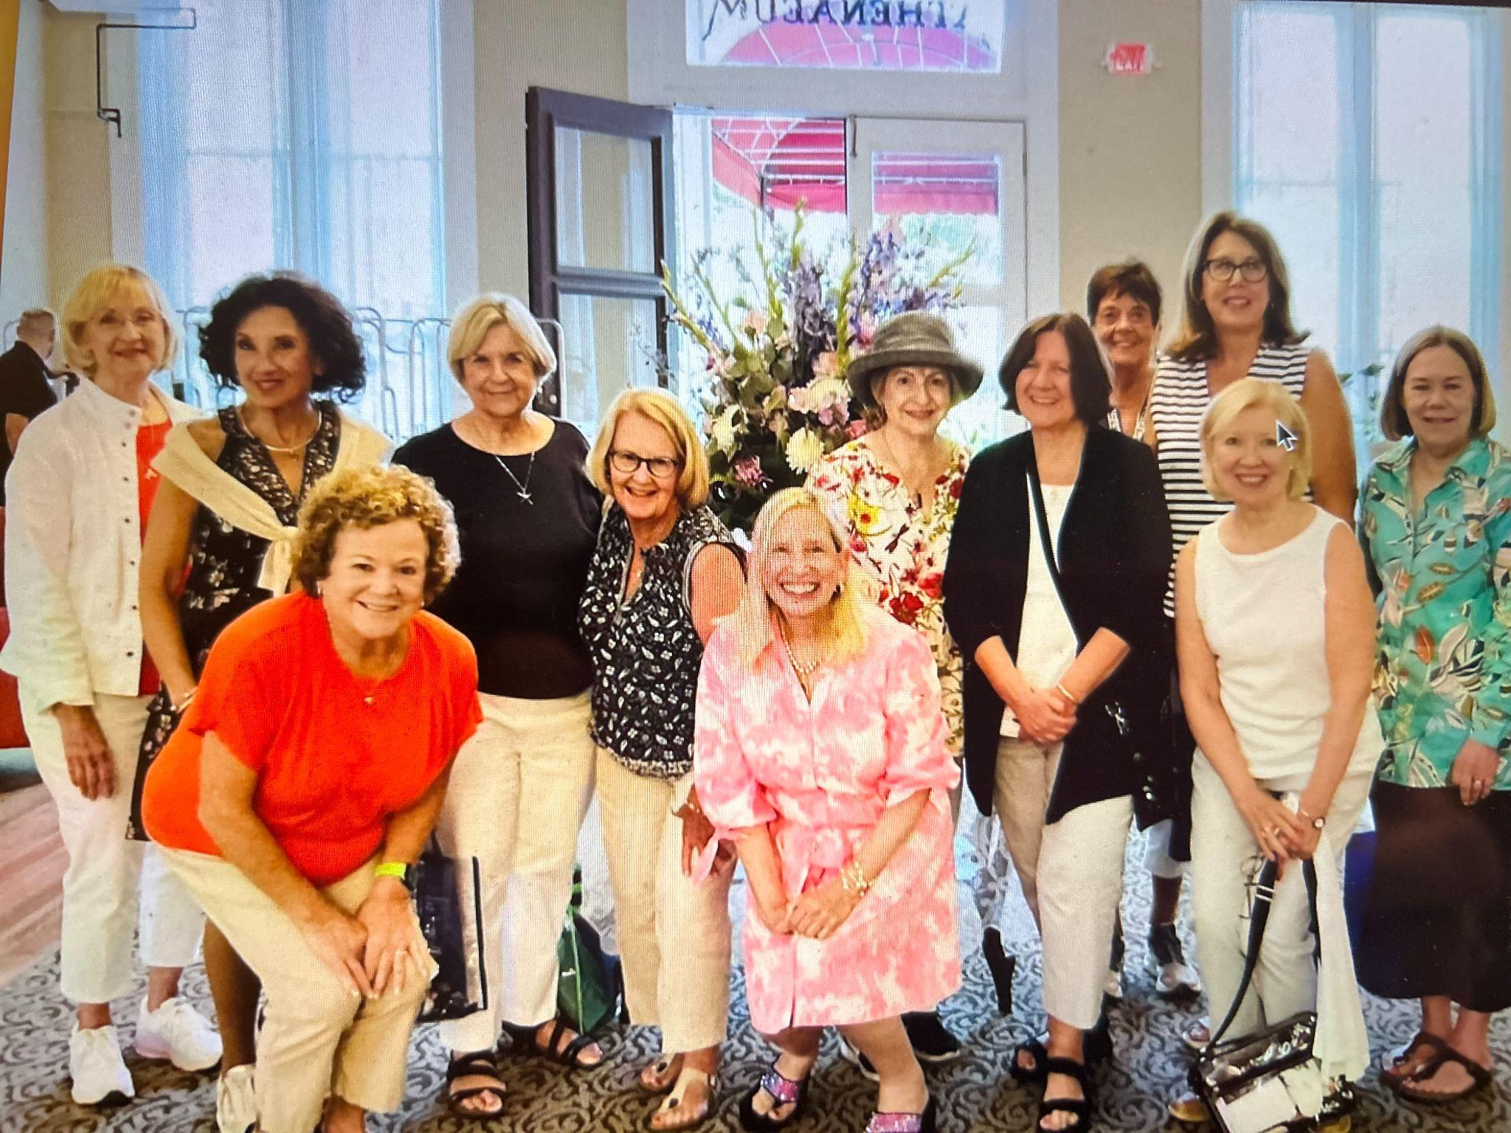
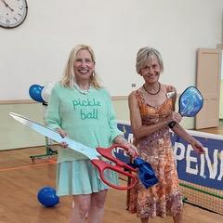
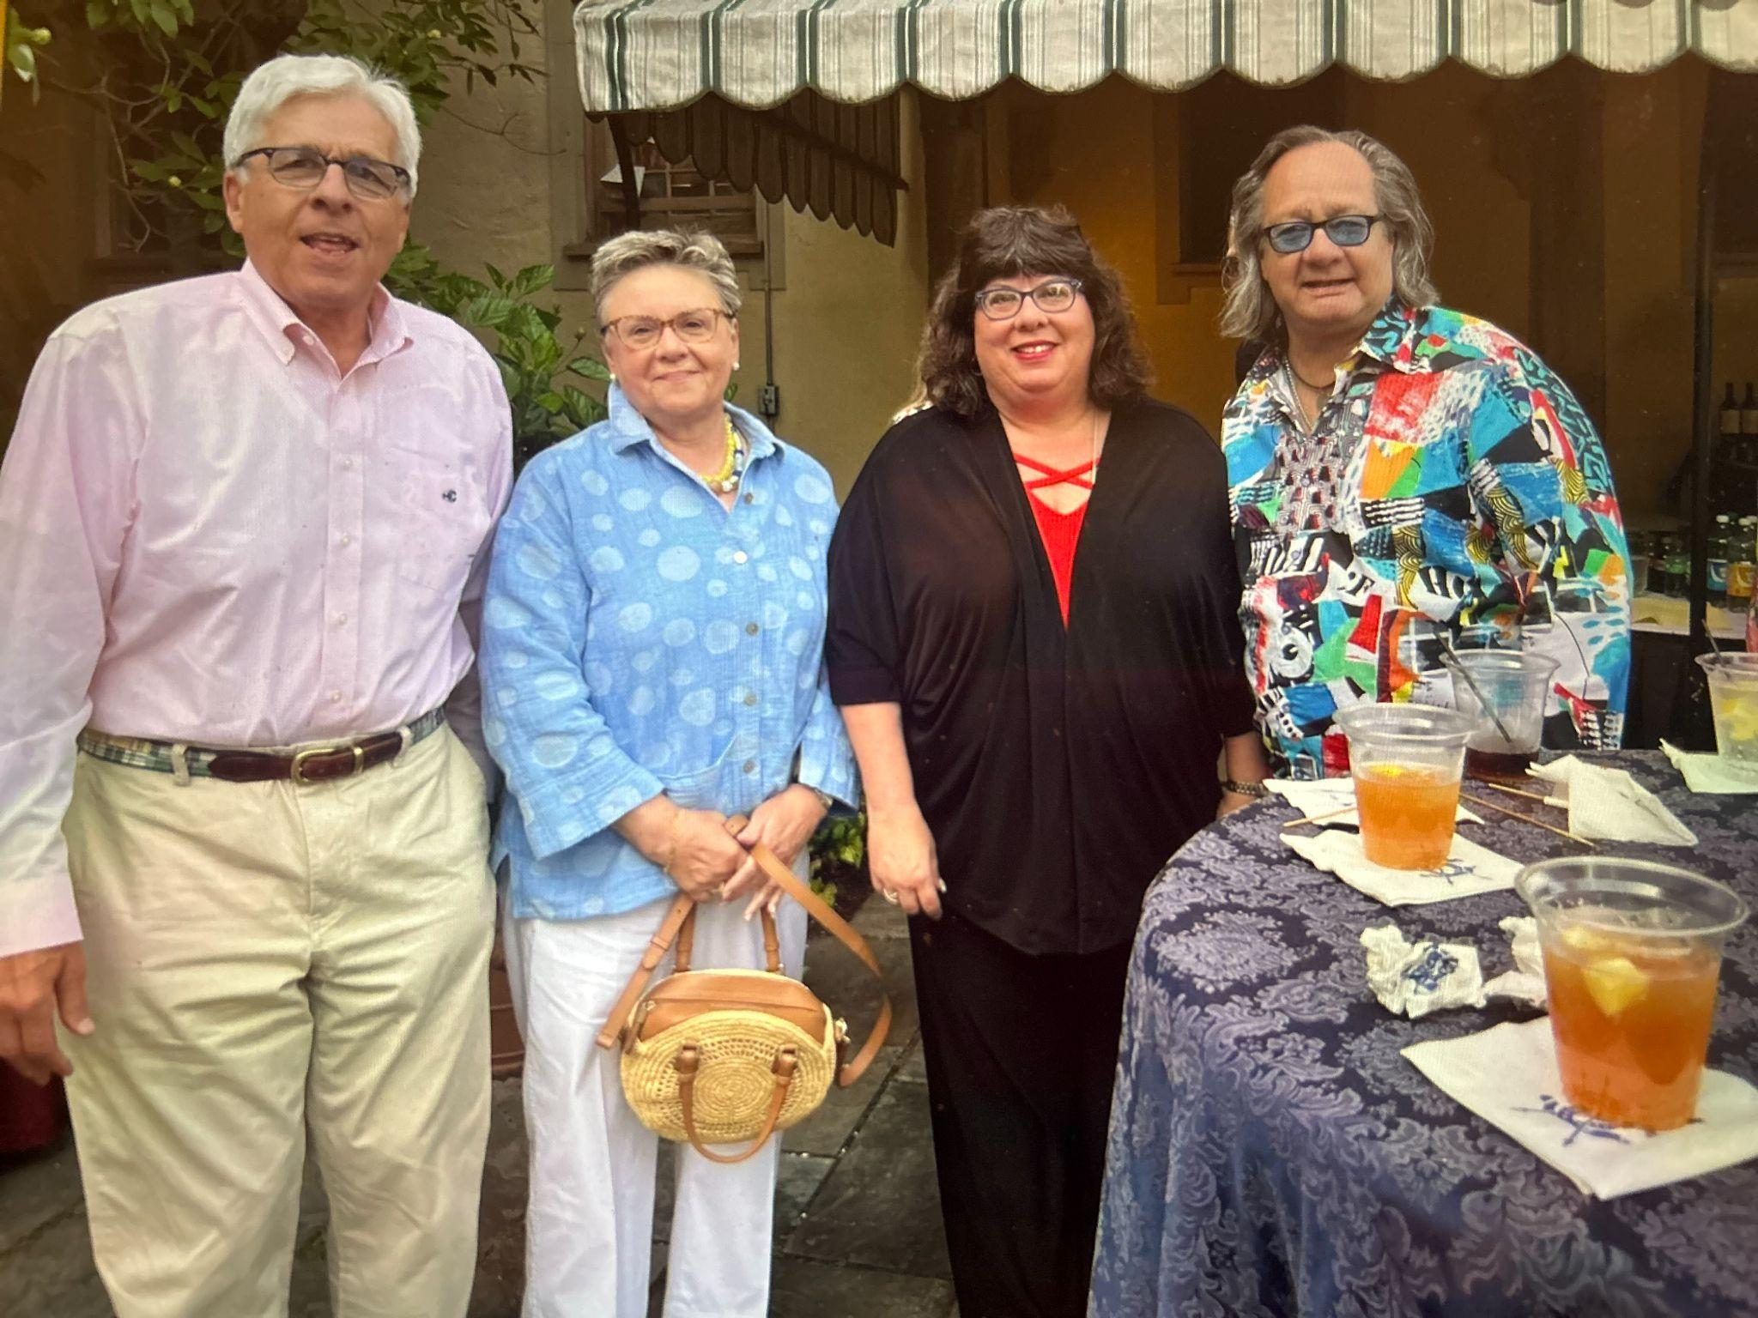
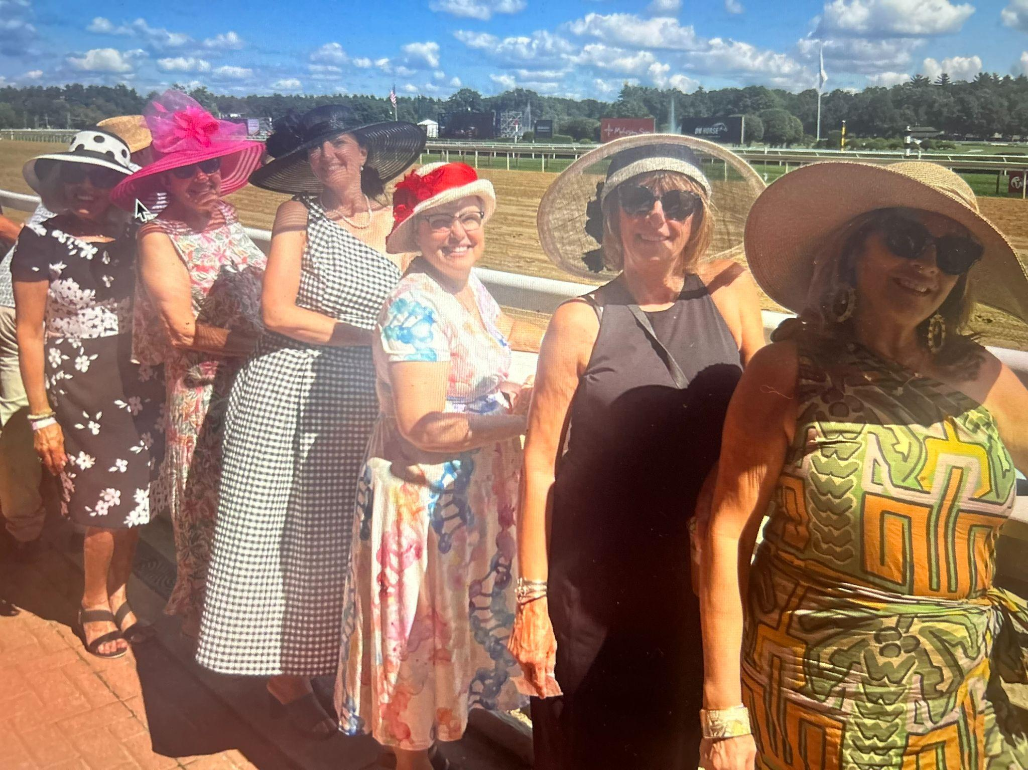
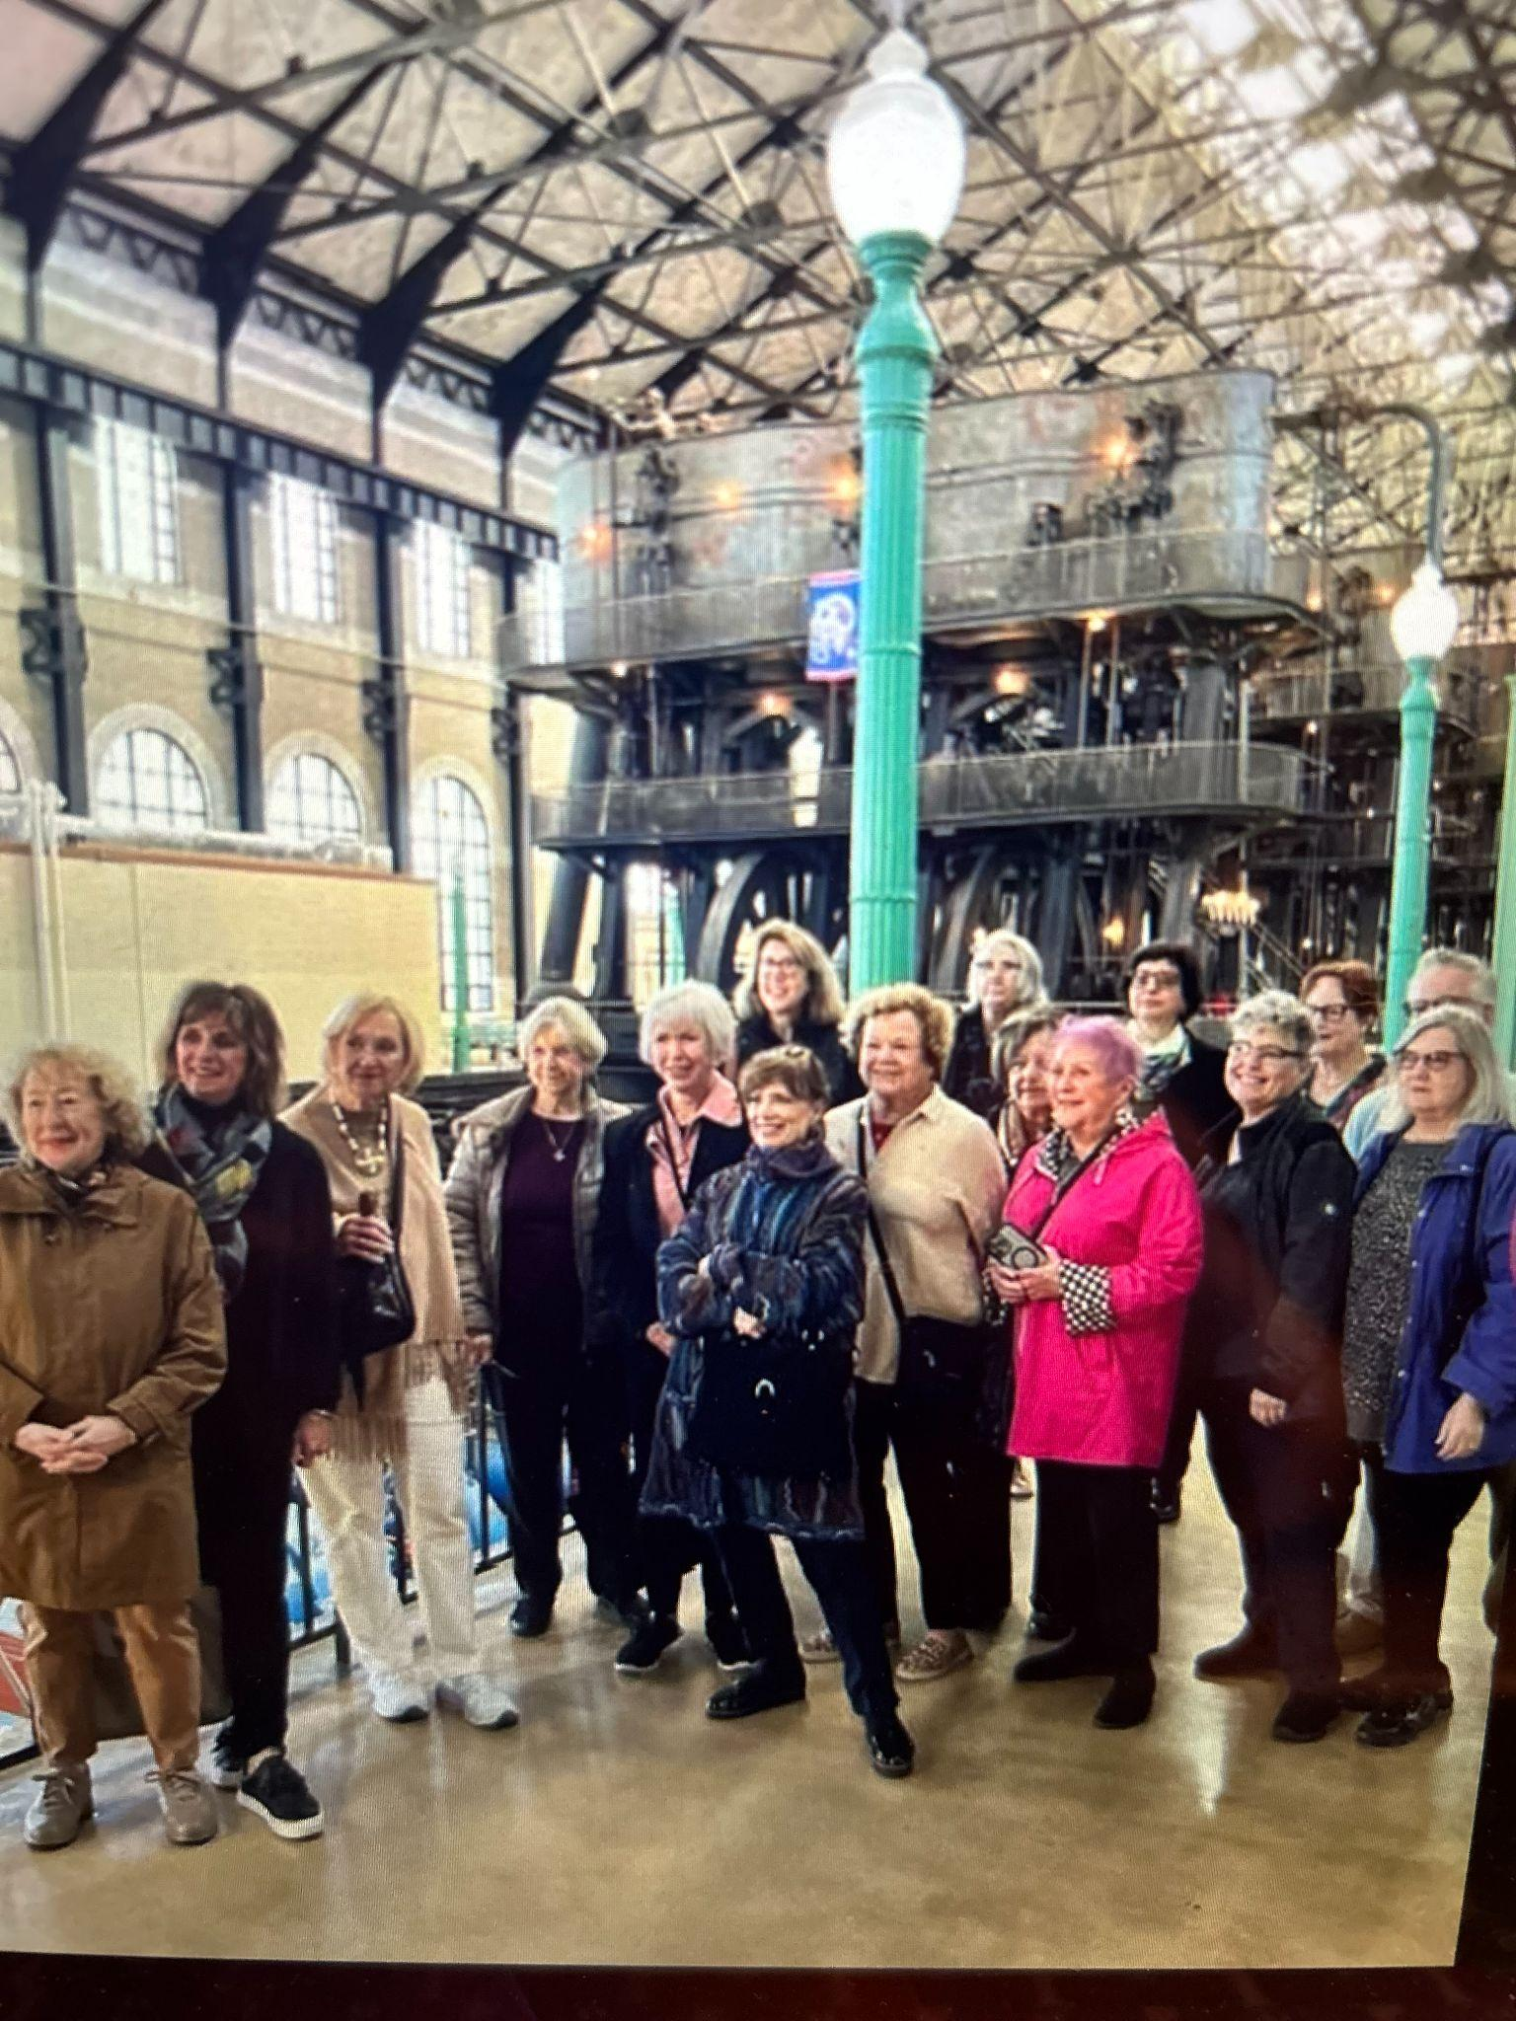
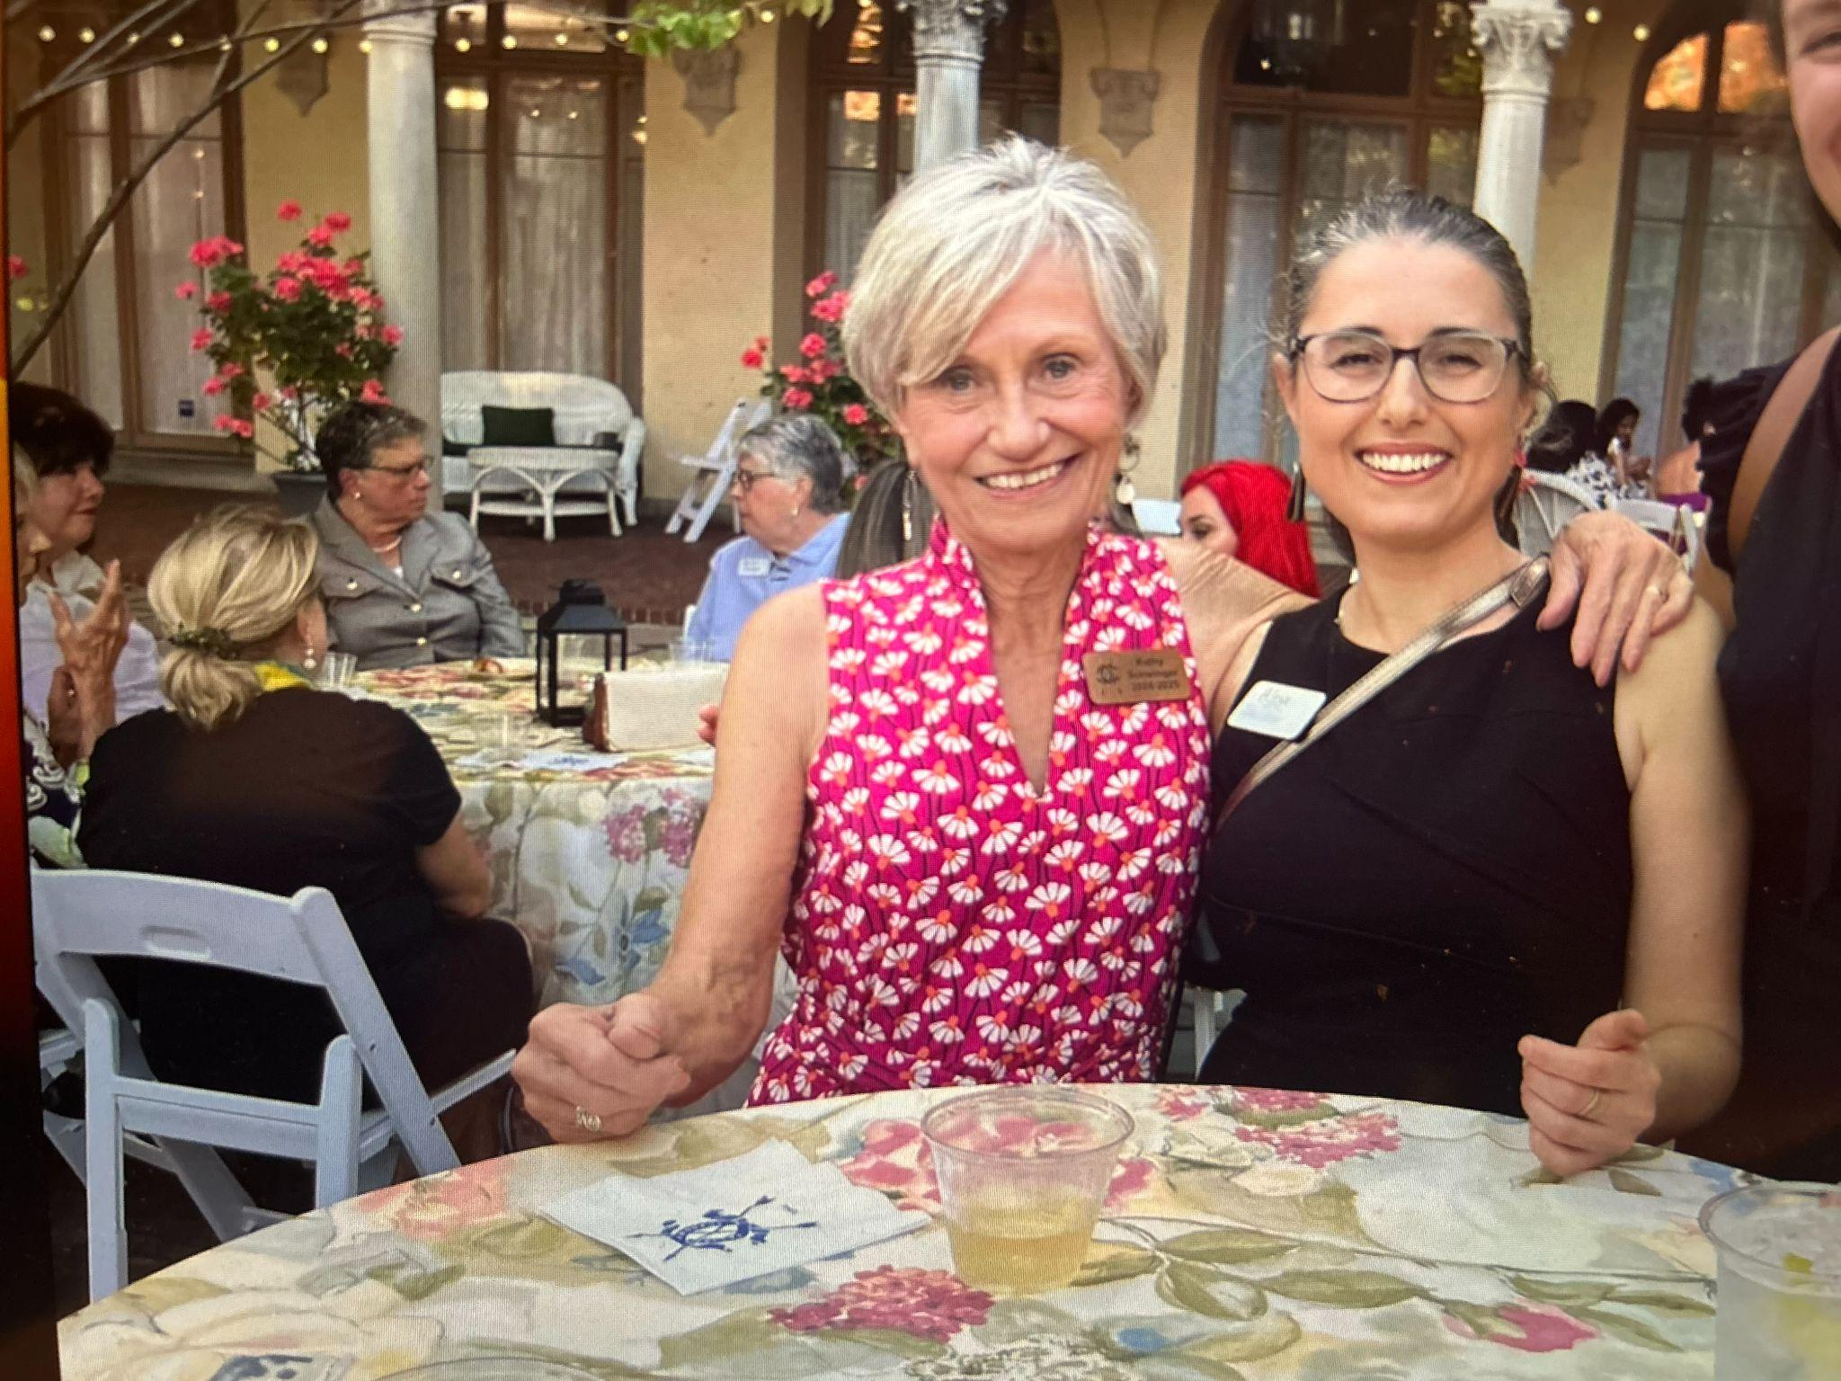

Slide 24
General Programs
Special Event Committees
Presidents Day | May 1 | Chairs Barb Bielecki Susan Grelick, Mitzie Serafin | 99
Mothers Day Brunch | May 12 | Chair Martha Rasmussen Co-Chair Liz Krawczyk | 115
130th TCC Celebration | October 5 | Chair Janice Worobec Co-Chair Kathie Homer | 99
Tree Lighting | December 7 | Chair Barb Burwick | 120
Holiday Program | December 18 | Chair President Schwinger | 122
Sweetheart Soiree | February 8 | Chair Emily Schaefer | 77
St. Pat’s Brunch | March 16 | Chair Norine Dunnigan Co-Chair Barb Bielecki | 144
Fashion Show | March 28 | Chair Diane Slawinowski Co-Chair Megan Forness | 98
Palm Sunday Brunch | April 13 | Chairs Jean Morrison, Lynn Morrison | 98
Presidents Ball | April 26 | Chairs Dianne Sippel, Kate Arundell | 99

Slide 25
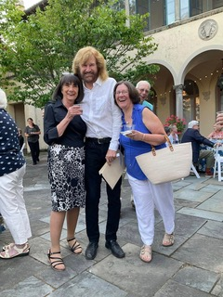
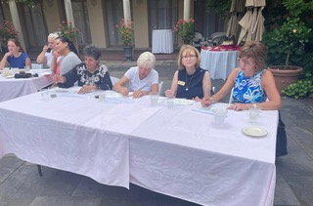
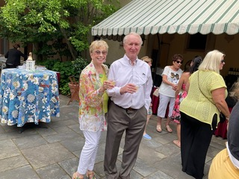
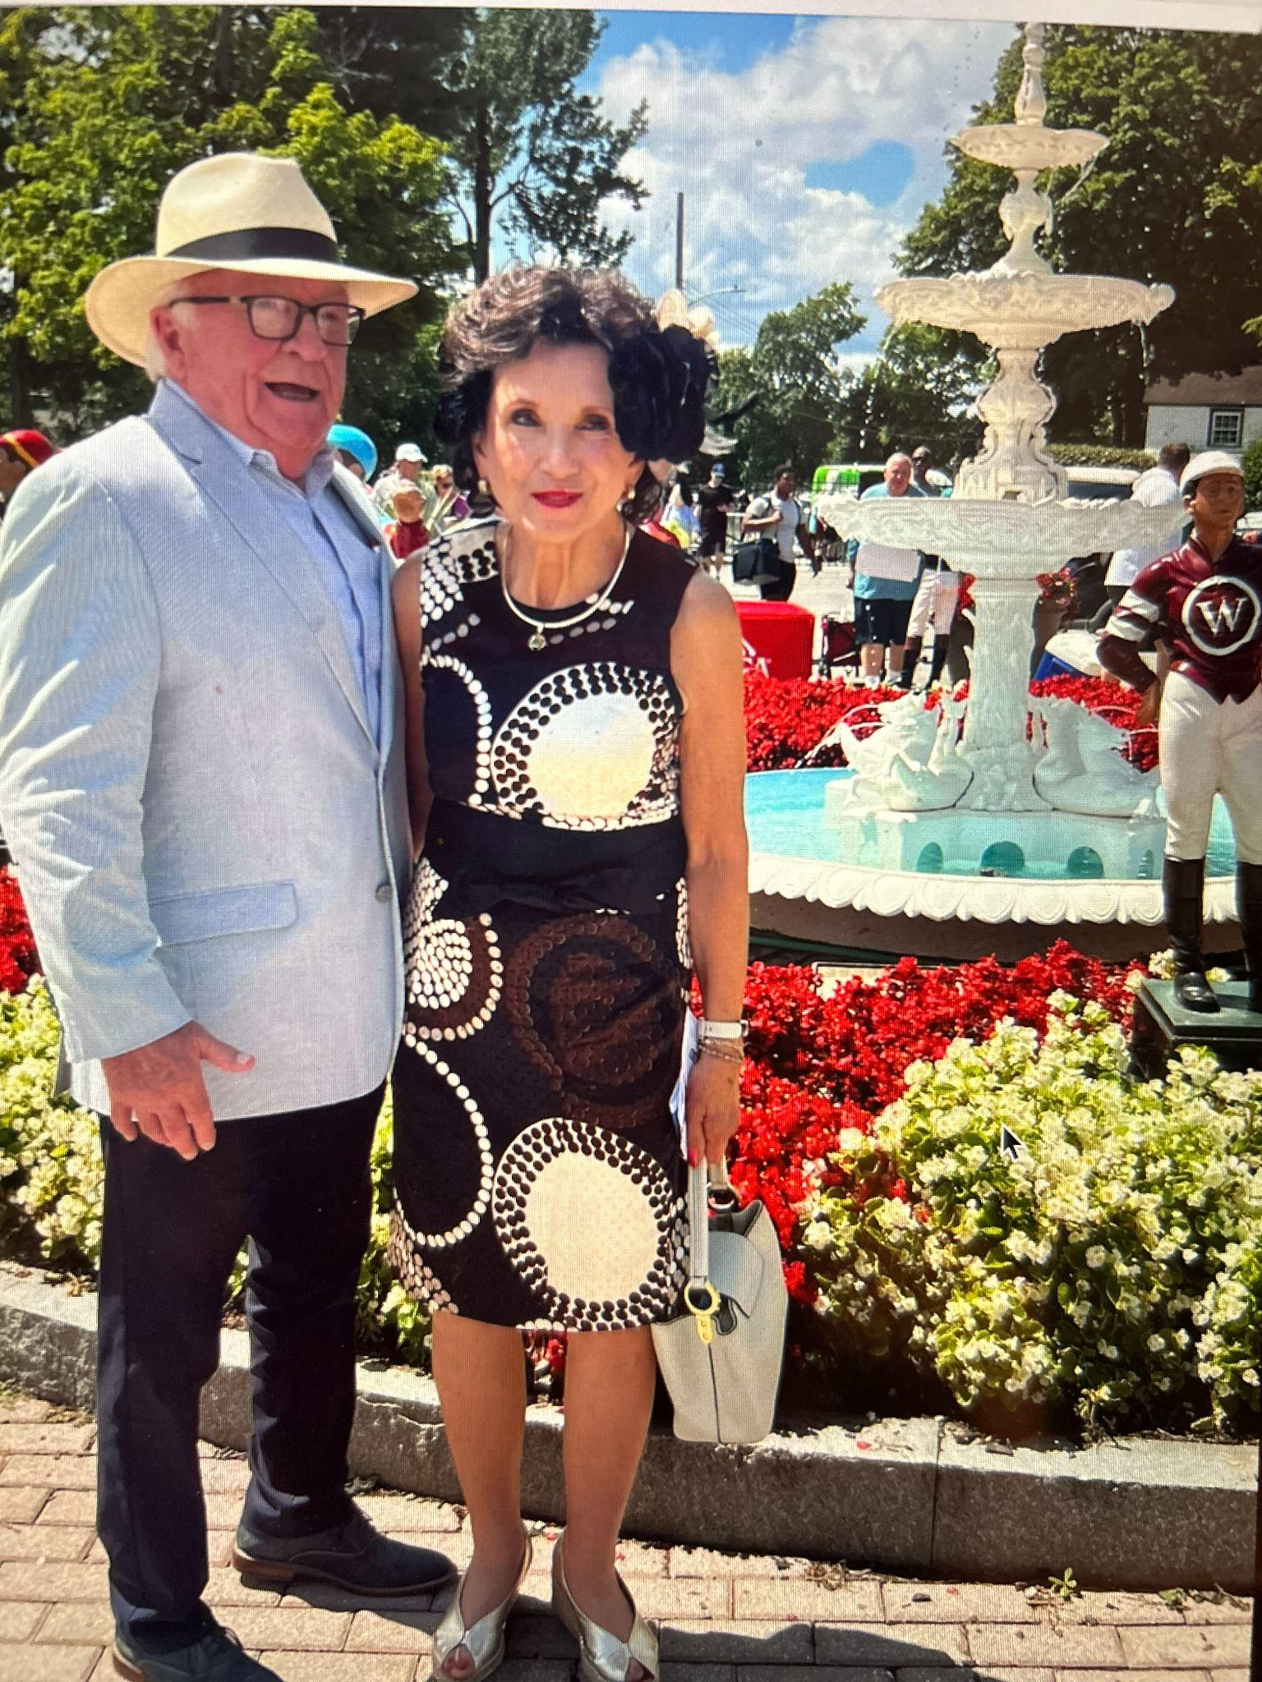
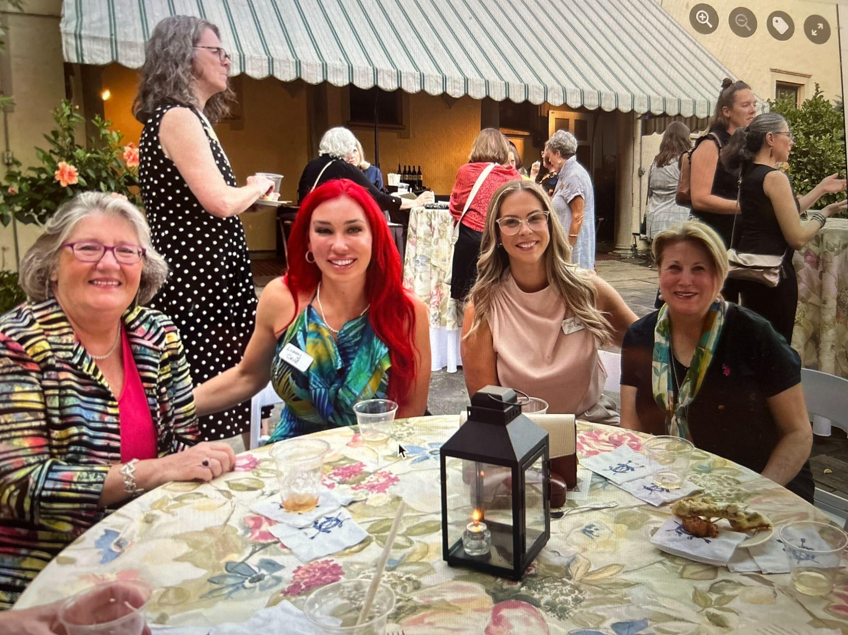

Slide 26
Social Committees
 | Chair/Co-Chairs | Events | Guests/Members
Anything Goes | Chair Isabelle Posner | Monthly | Varies
Bridge | Chair JoAnn Smith | Wednesday Pre-Program | Varies
Dining Divas | Chair Lisa Faturos | 6 Restaurants | 54
Evening Book Club | Chair Janice Worobec | Monthly | 120
Golf | Chair Kathy Schwinger | Weekly Summer | Varies
Mexican Train | Chairs Dru Hites, Soledad Proano | Weekly | Varies
Mahjong | Lee Martin | Wednesday Post Program | Varies

Slide 27
Social Committees
Trips and Tours | Chair Mary Lou Mancuso Co-Chair Susan Altman | 19 Bi-Monthly Tours, Saratoga Races | 228
Tuesday/Thursday Evenings | Diane Slawinowski Megan Forness | 6 Special Interest; 2 Music | 161/61
Evening Special Event | Chair Kathy Schwinger | Tom Toles | 66
Summer Dinners | Chair Erin Sullivan | 3 Dinners | 159
TCC Open House | Chair Joyce Barbalato | 1 Program | 35
Total Programs | 353 | Members/Guests | 710

Slide 28
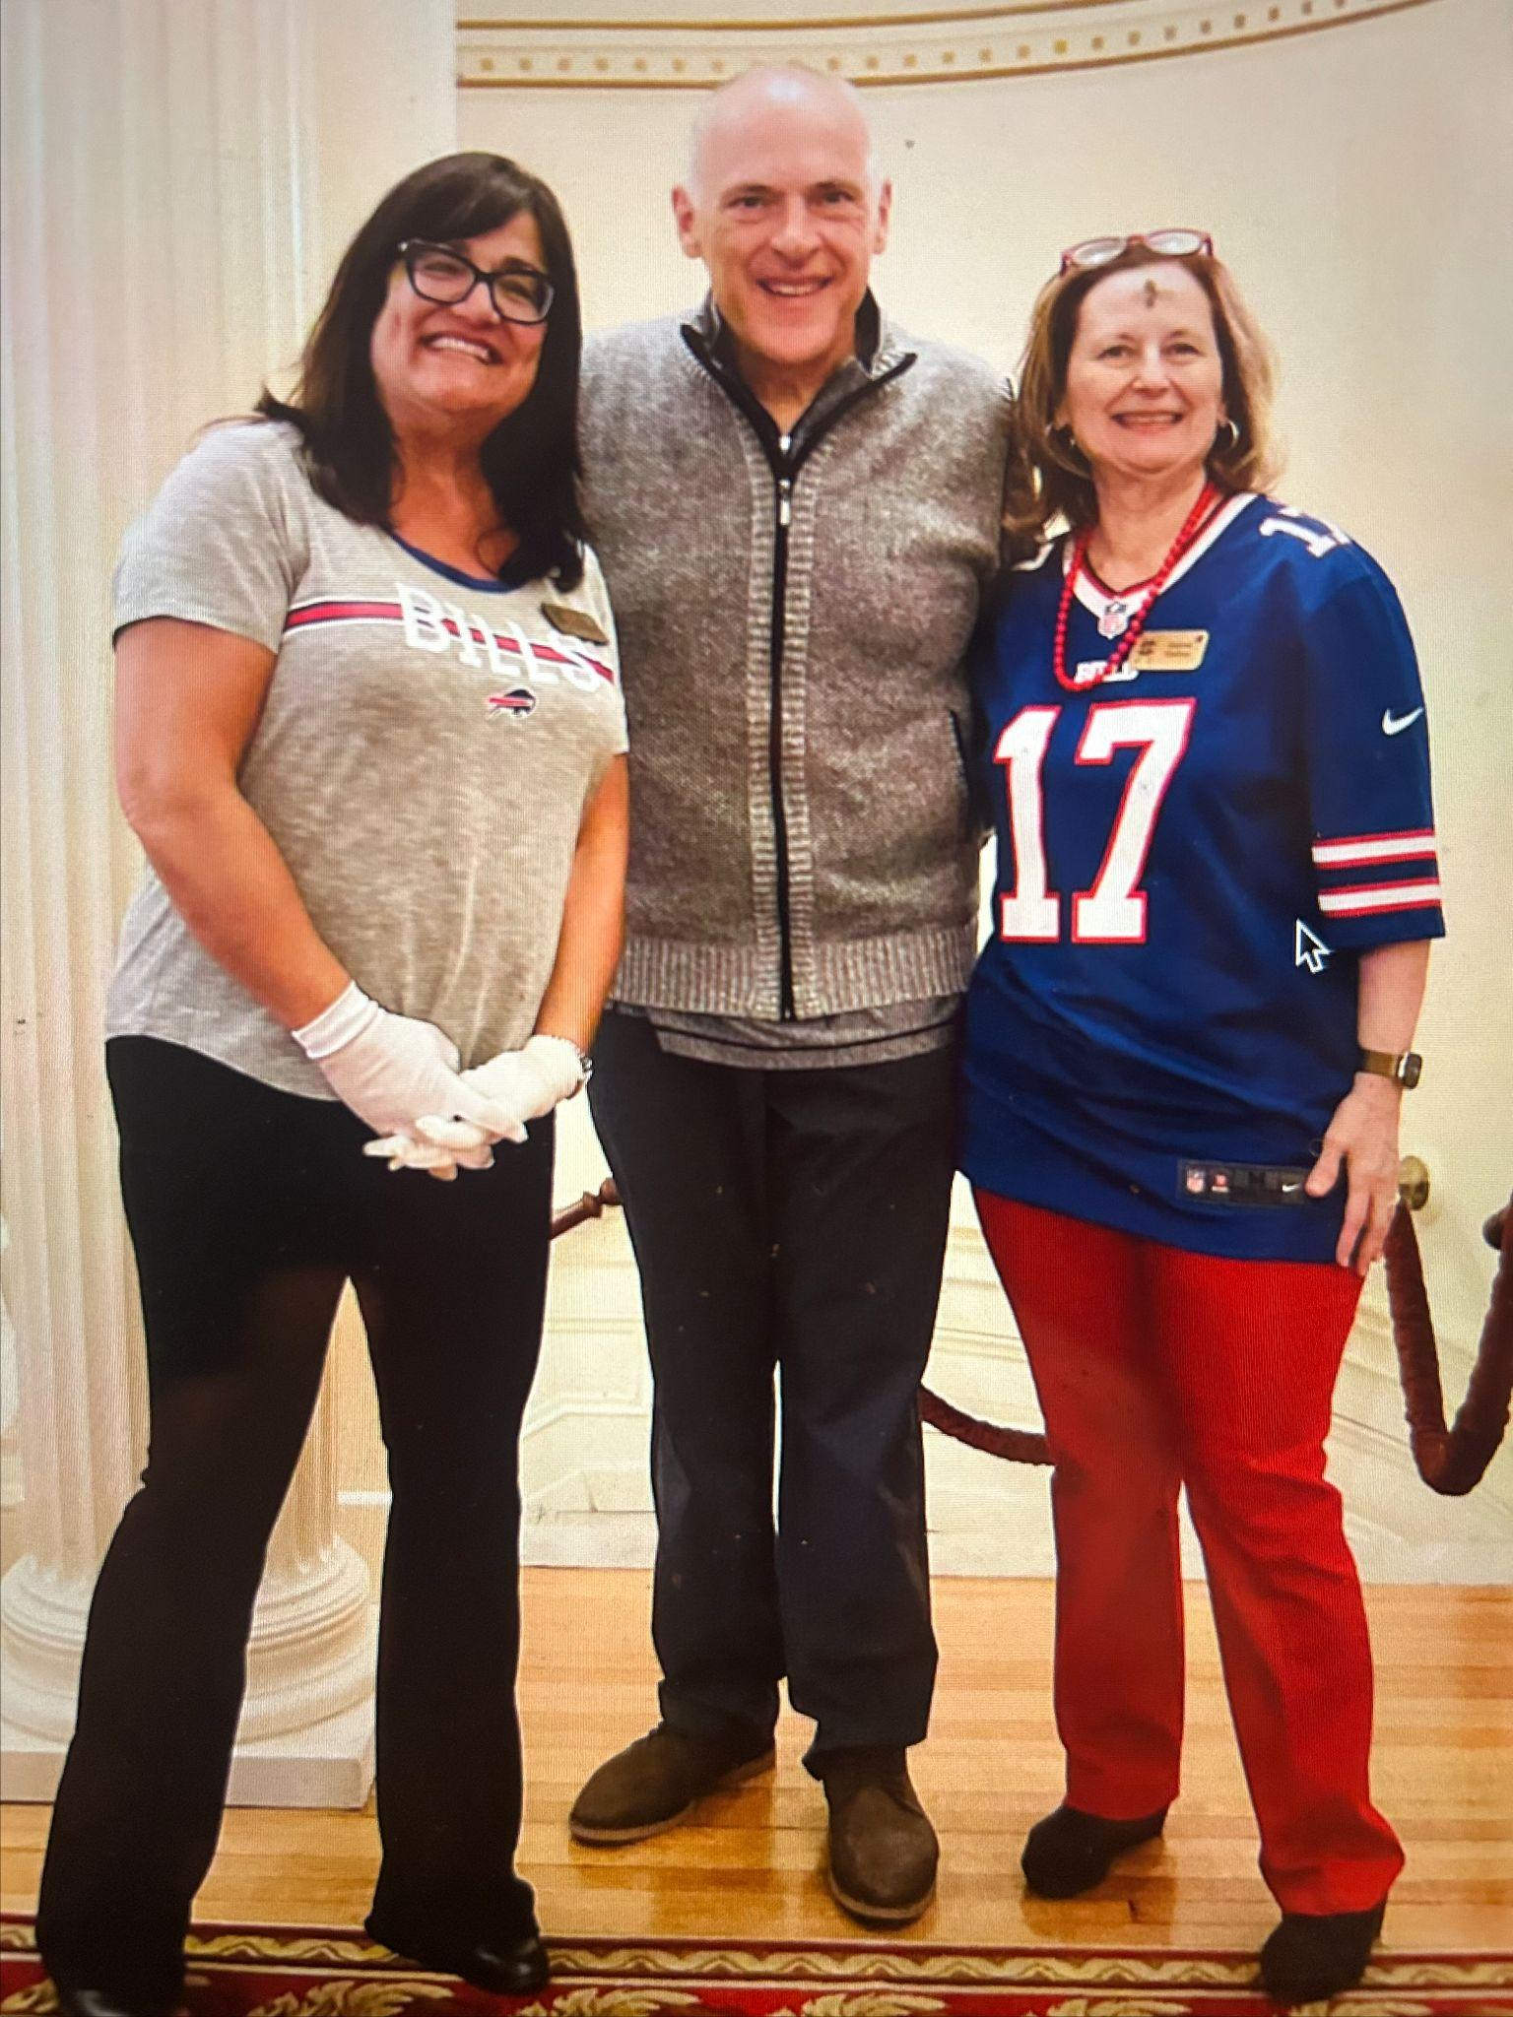
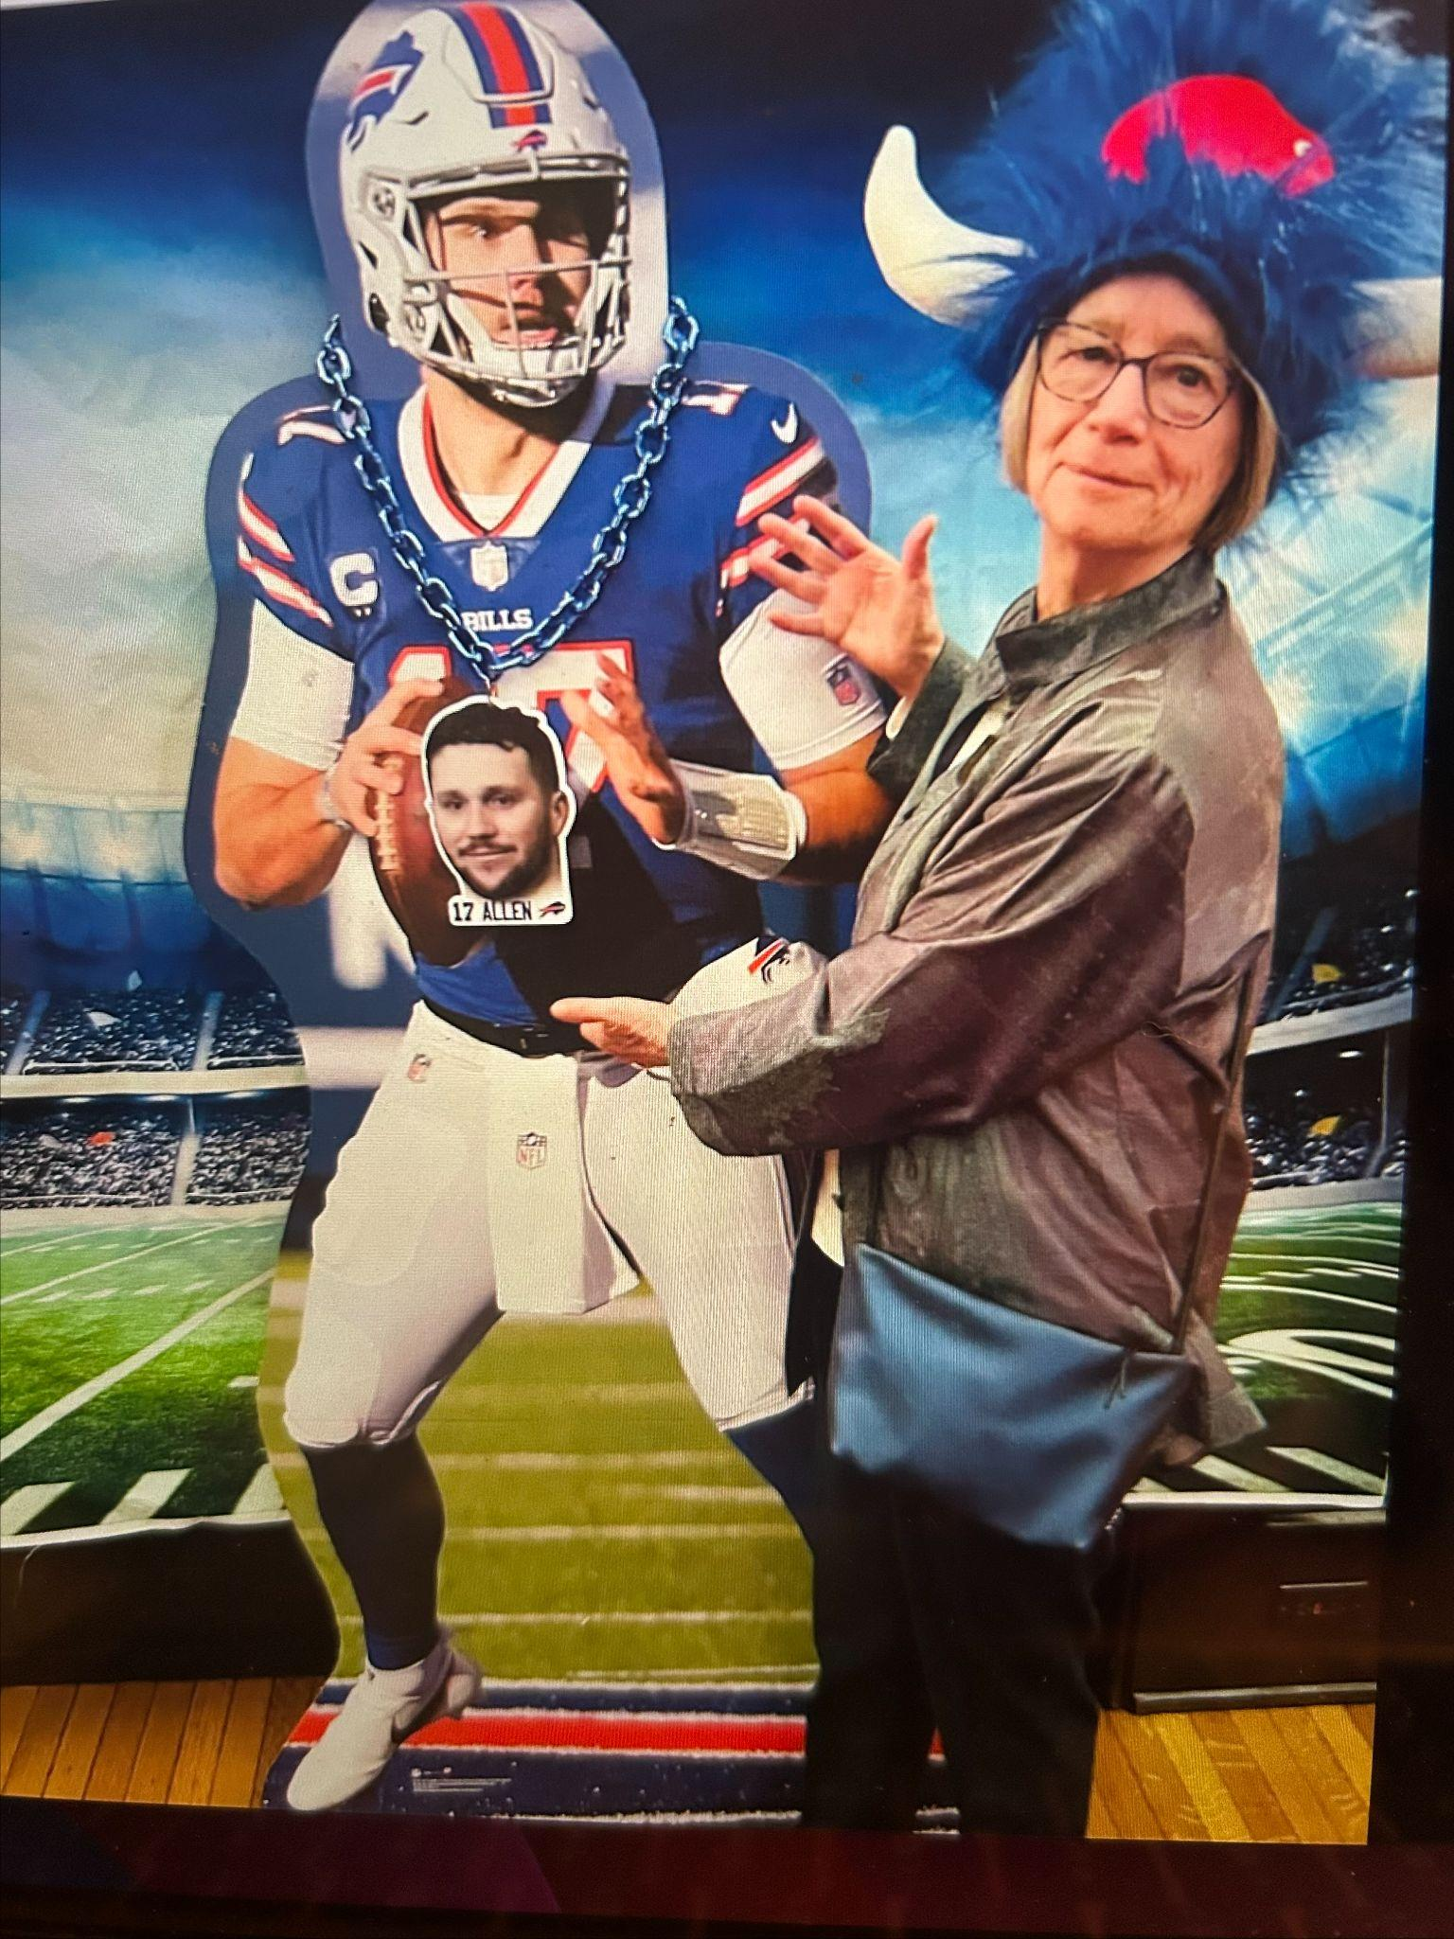

Slide 29
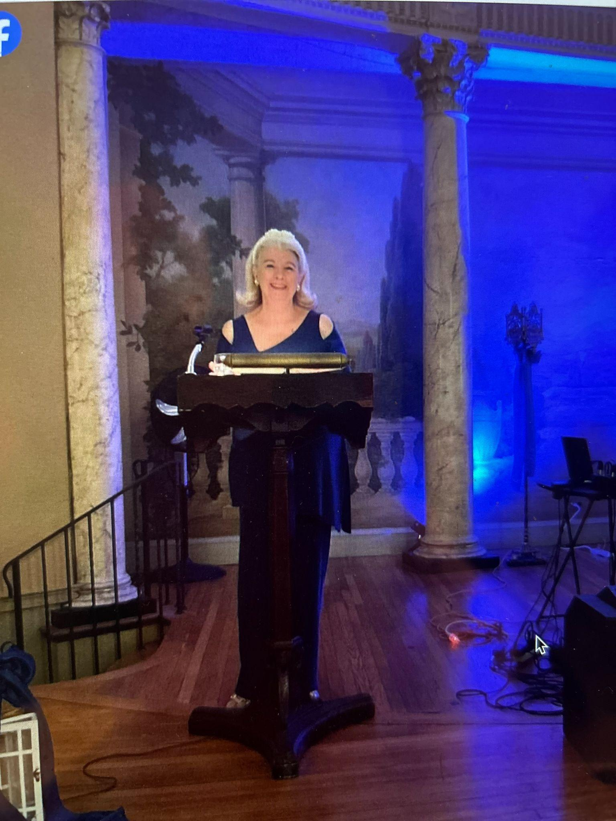
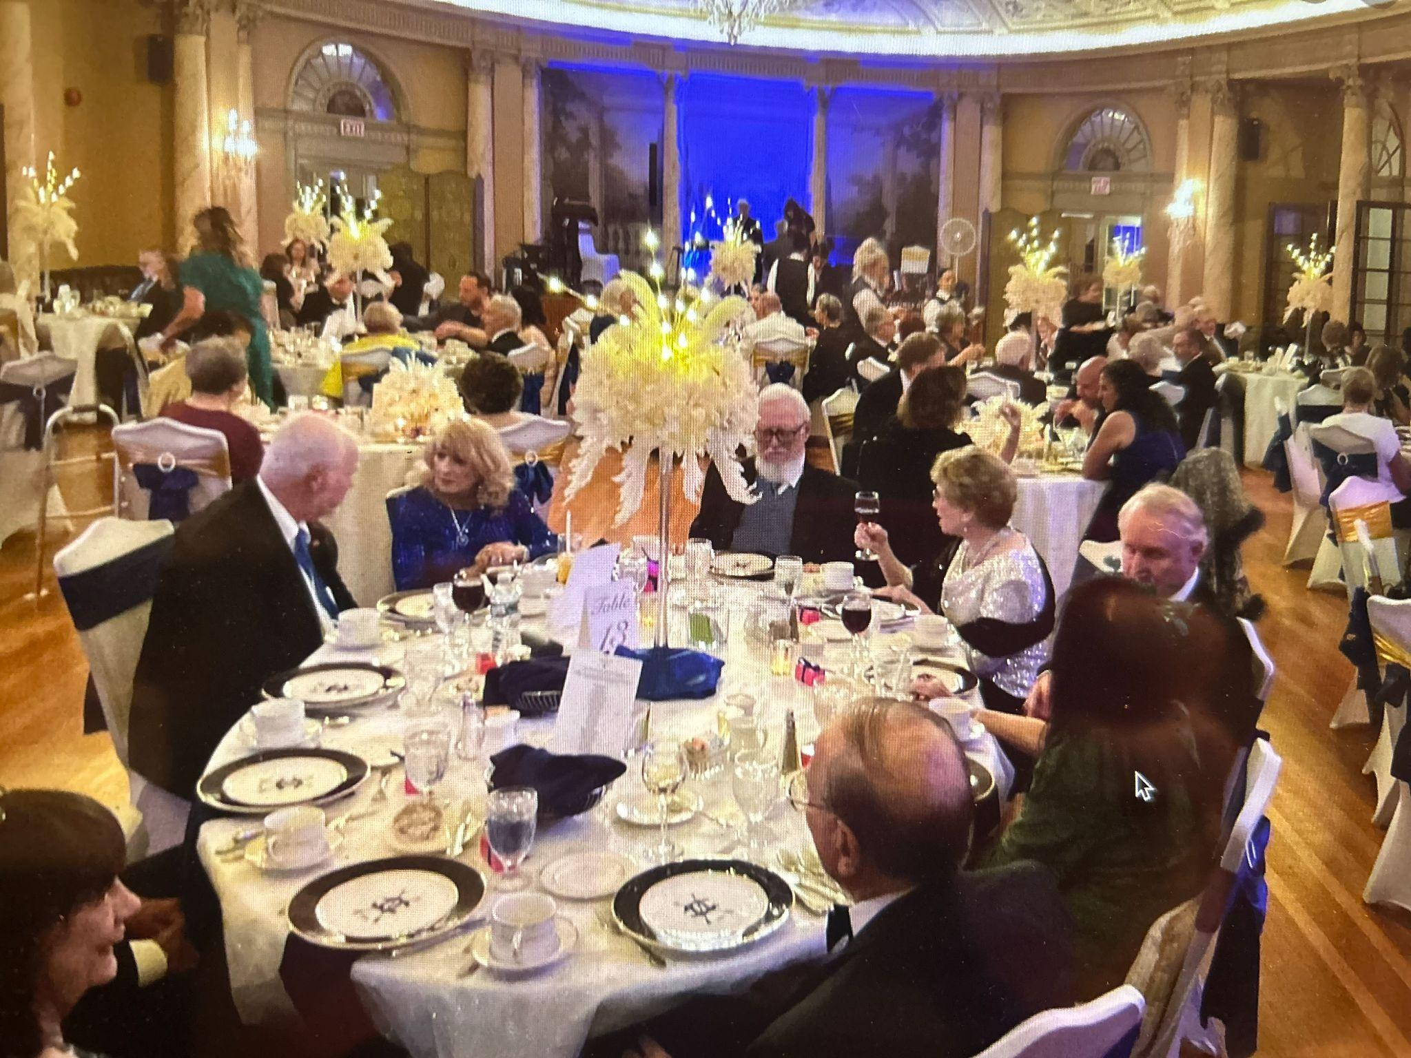
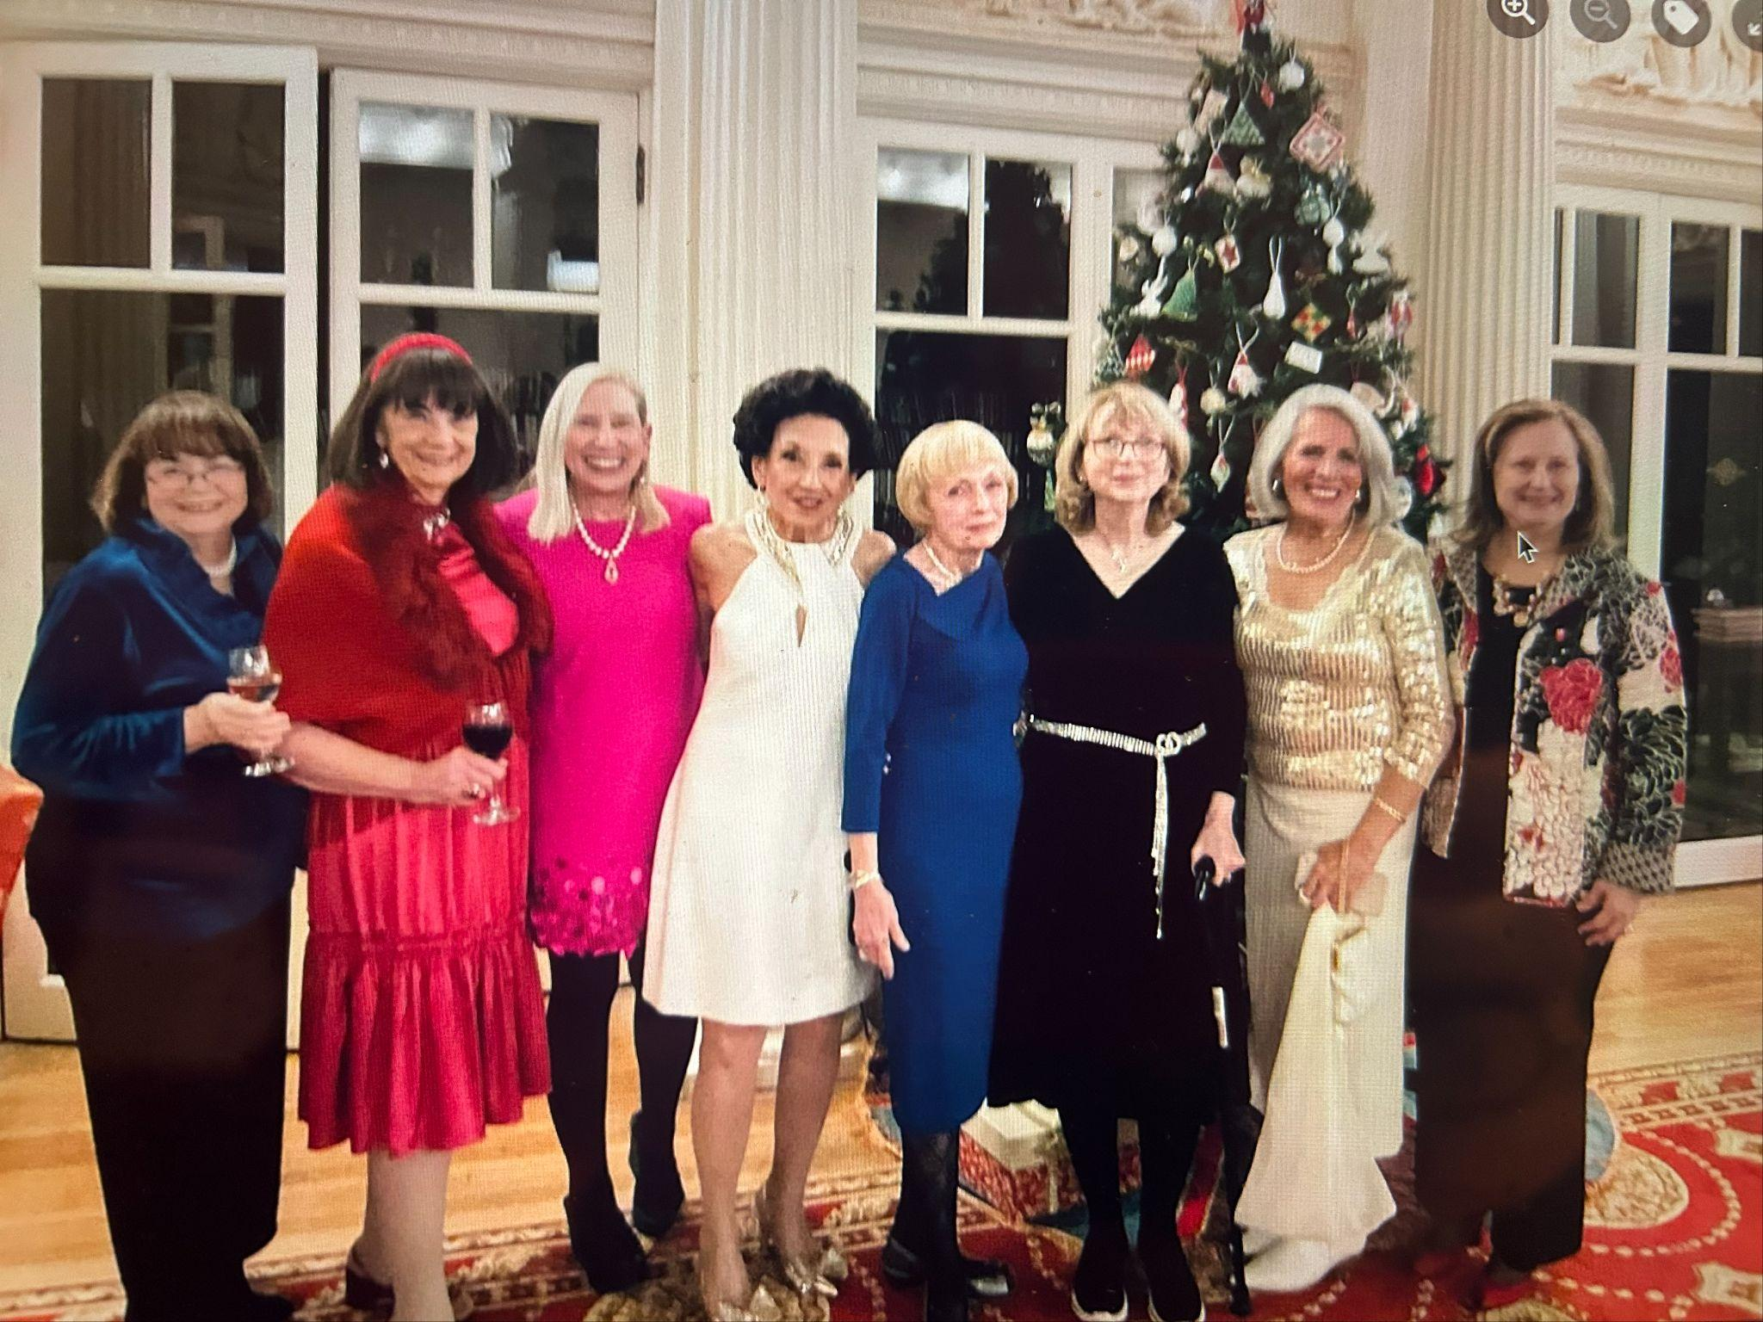

Slide 30
General Programs
Bridging The Seasons
May marking our new calendar year with our TCC traditions reigning, white gloves on, feating in every way possible our outgoing President and our previous Presidents on Presidents Day, followed by Mothers Day Brunch and the new program year with our TCC Open House, opening doors to prospective members, followed by our spectacular 130th Anniversary Dinner and tied up the Fall season with Sip, Shop and Wreath Making, readying us for the next season.
Beginning and Continuing Season Members and Guests: 386
Our gratitude to: Barb Bielecki, Susan Grelick & Mitzie Serafin, Martha Rasmussan, Joyce Barbalato, Janice Worobec & Kathie Homer, Diane Slawinowski and Megan Forness.

Slide 31
General Programs
Holidays are here…
Late in November, halfway through our TCC year, the TCC High Holiday Season began with the Club decked in greens, sparkle and glitter, packed with tradition: our Tree Lighting, Holiday Tea weather disrupted, but still with memories of the past, the fun Holiday Program, our Holiday Buffet, and rounding our our seasonal celebrations, our shimmering Candlelight Dinner.
Holiday Season Members & Guests: 420
Our great thanks to: Barb Burwick, Martha Rasmussen, Isabelle Posner, Kathy Schwinger, Diane Sippel, Kate Arundall
Winter's End…
February and March brought out our TCC Red & Greens in our Valentines Day Dinner and Saint Patricks Day Brunch.
Hearts & Shamrocks Season Members & Guests: 221
Our thanks to: Emily Schaefer, Norine Dunnigan & Barb Bielecki

Slide 32
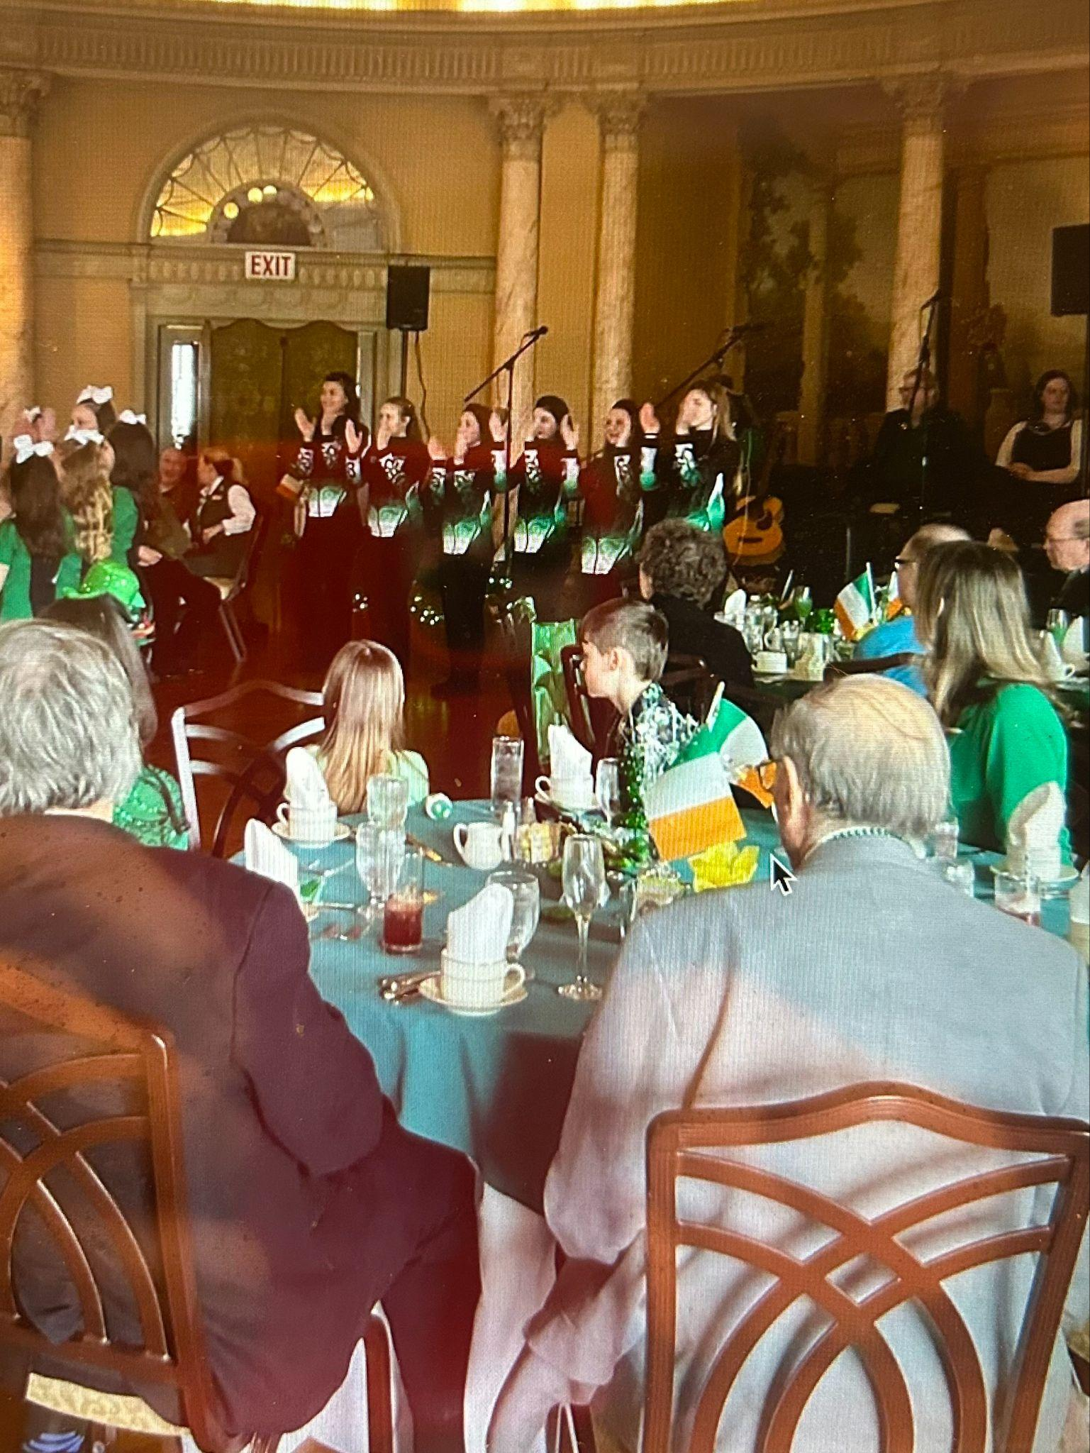
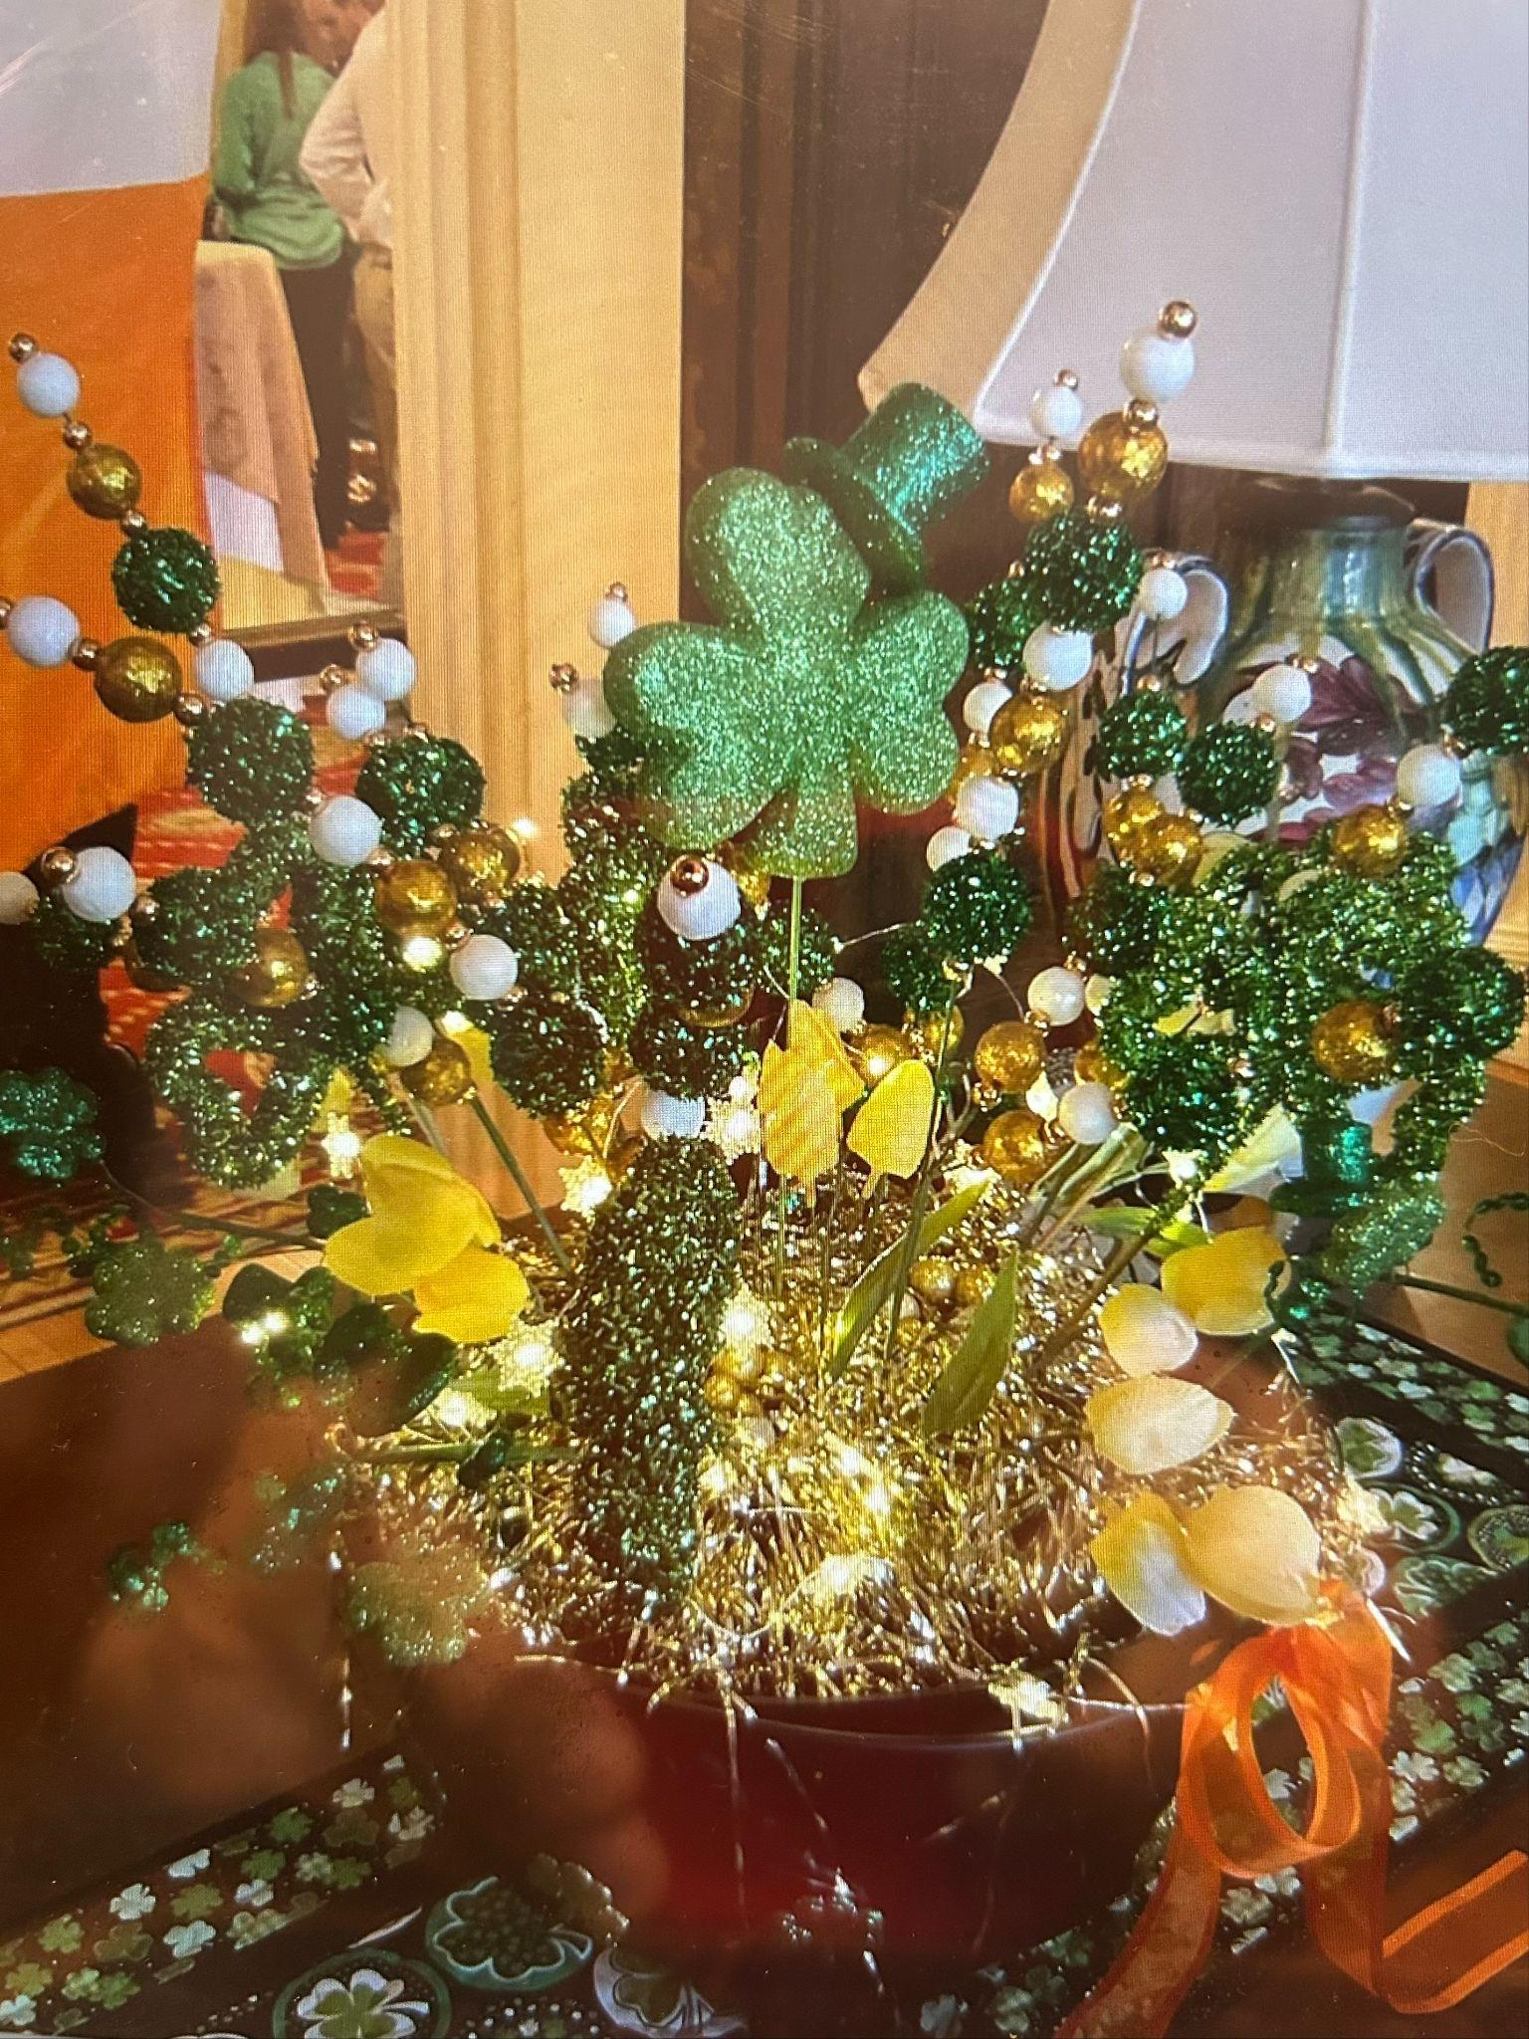

Slide 33
General Programs
T
Spring has Sprung: Lavender & Lace Luncheon, Red Carpet Fashion Show, Palm Sunday Brunch and the grand finale, the President’s Ball
Spring Season Members & Guests: 336
Our great thanks to: Barb Burwick, Liz Krawczyk, Diane Slawinowski & Megan Forness, Lynn & Jean Morrison, Dianne Sippel & Kate Arundell.
In Closing….
It was a year full of learning, adventures, celebrations, and new and enduring friendships.
My deepest appreciation for our Board of Directors, our amazing staff lead by Erin Sullivan and our Dining team led by Mary Jo Crowe, our Chef Danielle Carriere, our Club Traffic Controller, Briana Patterson, Ryan America, our many trades expert, and to all of our Chairs, Co-Chairs and you, our members for your many contributions and above all for your presence here on Wednesdays, for our many special events and gatherings, always at the heart of all that we do…

Slide 34
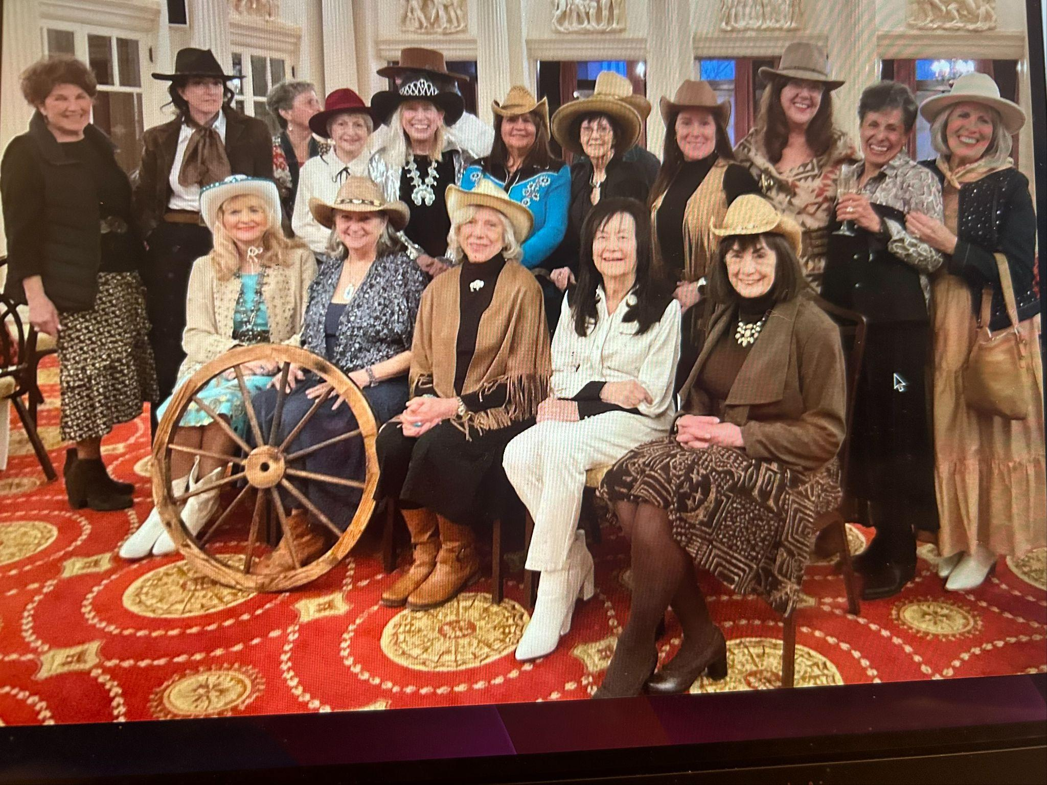

Slide 35
Endowment Memorial
Fund Committee
Annual Meeting
Report
April 30, 2025
Lee Grunert, Chair

Slide 36



Endowment Memorial Fund
Committee
Lee Grunert, Chair
*The EMFC was established in 1975 to build assets for the future sustainability of the Club and started with a modest initial investment. It has grown to more than $700,000.
*Given that new funds typically come from bequests and memorials, we are most appreciative of the members who have generously contributed $6100 this year to the Endowment Memorial Fund. This enables the EMF to increase the support to the TCC. We have simplified the process to make contributions
that will be clarified in the revised Policies & Procedures.
*Our portfolio is value-oriented with a high degree of dividend income. The principal is left intact; however, approximately half the yearly income is transferred to the Club’s operating budget.

Slide 37
Endowment Memorial Fund Continued
*The EMF Committee is comprised of members of the TCC who had served as President of the Club; and the BOD Finance Chair. The active members who currently serve include:
Kathryn Homer, Maria Schory, Martha Rasmussen, Judith Johannsen, Chris-Elaine Santilli, Elizabeth Krawczyk, Antoinette Louden, Janice Worobec, and myself.
*The Finance Chair apprises the EMF Committee of the
Club’s overall financial status.
*The Committee reports to the TCC Board of Directors on a quarterly basis and as requested by the Board

Slide 38
Endowment Memorial Fund Continued
Financial Report: May 1, 2024 – March 30, 2025
Cash Account, May 1, 2024 $ 6024
Cash Receipts:
Dividends 20,736
& Interest
Donations/Memorial 6,105
Sales of securities 29,995
Total Cash Receipts
$ 56,836

Slide 39
Endowment Memorial Fund Continued
Cash Disbursements:
$30,000
Gifts to Club
December, 2024
April, 2025
April, 2025 $15,000
Purchases of securities $17,274
Total Disbursements $62,274
Cash Account, March 30, 2025 $ 586

Slide 40
Endowment Memorial Fund Continued
PORTFOLIO – TRUBEE WEALTH ADVISORS
March 30, 2025
Cash $586
Investments $778,639
Total Portfolio Account $779,225
(4/15/25 $741,833)

Slide 41
Endowment Memorial Fund Continued
*We, the Past Presidents of the Endowment Memorial Fund Committee commend you, Kathleen Schwinger, for your leadership and your Board of Directors for its tireless
efforts and dedication throughout the 2024-25 Club year.
*As a key role of the EMF, we hereby gift the Twentieth Century Club $15,000 which will be deposited directly
into the TCC general fund. This is in addition to the $30,000 gifted in December 2024 for the floors for a total of $45,000 for the 24-25 Club year.
Respectfully submitted, Lee Mary Grunert (EMF Chair)

Slide 42
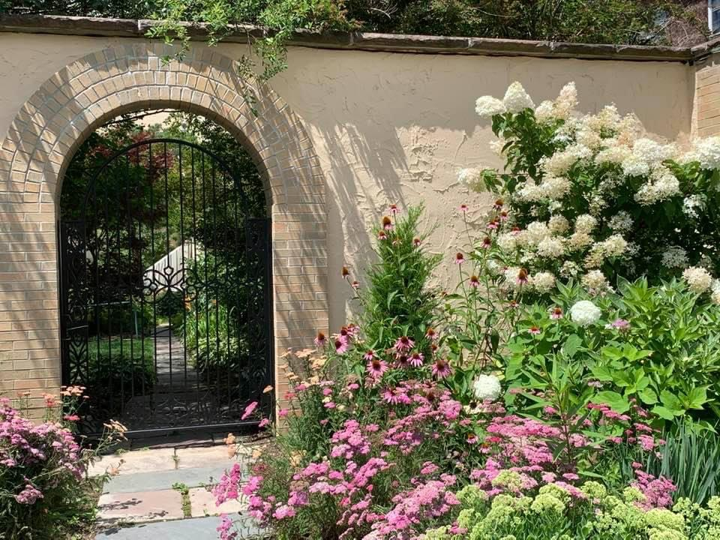

Slide 43
BYLAWS – Kathleen McCarthy
PROPOSED AMENDMENT TO -Article VI Nominations and Elections. Section 3. Eligibility for Director:
Current Language: Only those who have been members of the Club for at least three (3) years (prior to May 1) are eligible for the office of Director.
Proposed Language: Only those who have been members of the Club for at least two (2) years (prior to May 1) are eligible for the office of Director.
Rationale: This change was recommended by the Nominating Committee which noted there were many members with 2 or more years of memberships, but not quite 3 years who displayed their interest and enthusiasm for the Club. Many have already taken on leadership roles in committees. They would have been good candidates for the Board. Lessening the length of membership will increase the pool of candidates.

Slide 44

BYLAWS
PROPOSED AMENDMENT TO Article VI. Section 6. Nomination of Directors. c. Slate of Candidates:
Current Language: There will be a single slate of five (5) candidates for Directors. The slate will be presented to the Board of Directors at its first meeting in February and will be the slate for the electing of five (5) Directors. the slate of candidates will be posted on the bulletin board on the same day it is presented to the Board of Directors. No nominations will be made from the floor.
Proposed Language: There will be a single slate of five (5) candidates for Directors. The slate will be presented to the Board of Directors at its first meeting following the formation of the slate, but no later than its meeting in February and will be the slate for the electing of five (5) Directors. the slate of candidates will be posted on the bulletin board on the same day it is presented to the Board of Directors. No nominations will be made from the floor when the slate is presented at the Annual Meeting in April.
Rationale: If the Nominating Committee is able to form a slate of candidates by the time the Board meets in January, it would be unnecessary to wait until February to make the presentation to the Board. This will allow the incoming President to have more time to determine committee assignments for all members of the Board.

Slide 45
BYLAWS
PROPOSED AMENDMENT TO Article VI. Section 7. Nomination and Election of First Vice President/President Elect
Current Language The First Vice President is the President-Elect. The Nominating Committee will nominate a member of the Board of Directors or from the general membership for the Office of First Vice President/President-Elect. If from the general membership, the member must have served on the Board of Directors previously. The name of the nominee will be presented to the Board of Directors at the February Board meeting. Election will be by a majority of Board members present and voting. The First Vice President/President-Elect will be presented to the membership of the Club at the next Wednesday meeting following the election and the term of office as First Vice President/President-Elect will begin on the first Wednesday in May. The term is for one (1) year or until a successor is elected.
Proposed Language: The First Vice President is the President-Elect. The Nominating Committee will nominate a member of the Board of Directors or from the general membership for the Office of First Vice President/President-Elect. If from the general membership, the member must have served on the Board of Directors previously.

Slide 46
BYLAWS
Continued…Article VI. Section 7. Nomination and Election of First Vice President/President Elect
The name of the nominee will be presented to the Board of Directors at its first Board meeting following the committee’s nomination, but no later than the February Board meeting. Election will be by a majority of Board members present and voting. The First Vice President/President-Elect will be presented to the membership of the Club at the next Wednesday meeting following the election and the term of office as First Vice President/President-Elect will begin on the first Wednesday in May. The term is for one (1) year or until a successor is elected.
Rationale: This will enable the presentation of the First Vice President to the membership at the same time as the slate of candidates for Board positions is presented to the membership.

Slide 47
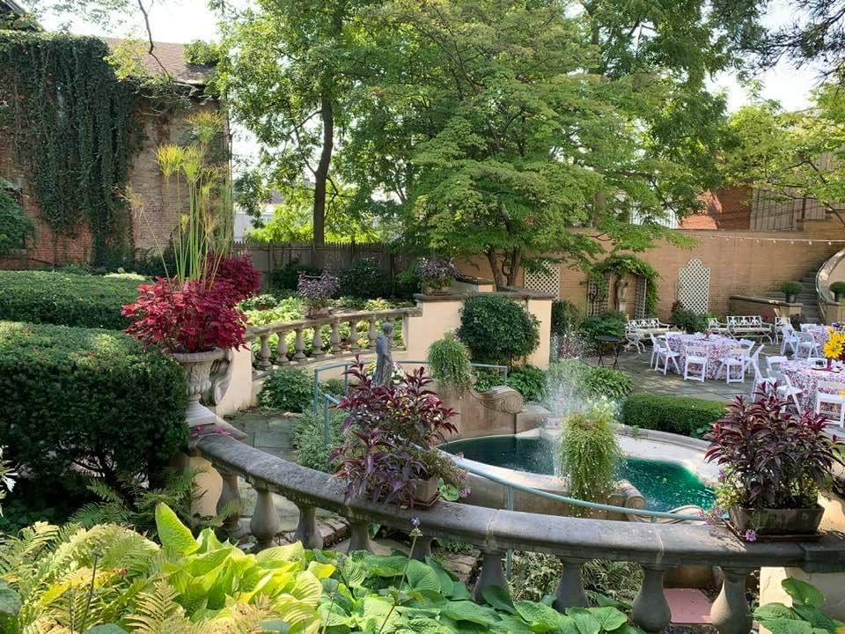

Slide 48
NOMINATING COMMITTEE
KATHLEEN MC CARTHY
As Chair of the Nominating Committee, we recommend the following candidates for the Board of Directors for three-year terms ending in 2028:
Susan Altman
Barbara Arnold
Dawn Halverson
Marcia Myszka
Diane Slawinowski
This slate was approved at the February 25, 2025 Board meeting. Madam President, I request a motion and second from the floor.

Slide 49
2024-2025 Board of Directors
Executive Committee / Officers:
President – Kathy Schwinger
First Vice-President / President-Elect – Susan Grelick
Bylaws / Second Vice-President – Kathleen McCarthy
Recording Secretary – Mitzie Serafin
Corresponding Secretary – Jean Jain
Finance Chair – Ann Demopoulos
Treasurer – Janet Bevilacqua
Assistant Treasurer – Elizabeth Hulley
General Program Chair – Tish Brady

Slide 50
2024-2025
Board of Directors
Directors:
Membership – Candy Broman
Communications –
Personnel – Barb Arnold
Dining Room – Melissa Parrish
House Furnishings – Megan Forness
Building and Grounds – Kate Arundell
A heartfelt thank you to our Board Members who
constantly uphold our Club’s best interests.

Slide 51
Board of Directors Terms
Expiration of Terms
2026 2027 2028
Susan Grelick Mitzie Serafin Susan Altman
Kate Arundell Janet Bevilacqua Barb Arnold
Ann Demopoulos Tish Brady Dawn Halvorsen
Jean Jain Candy Broman Marcia Myszka
Megan Forness Diane Slawinowski

Slide 52
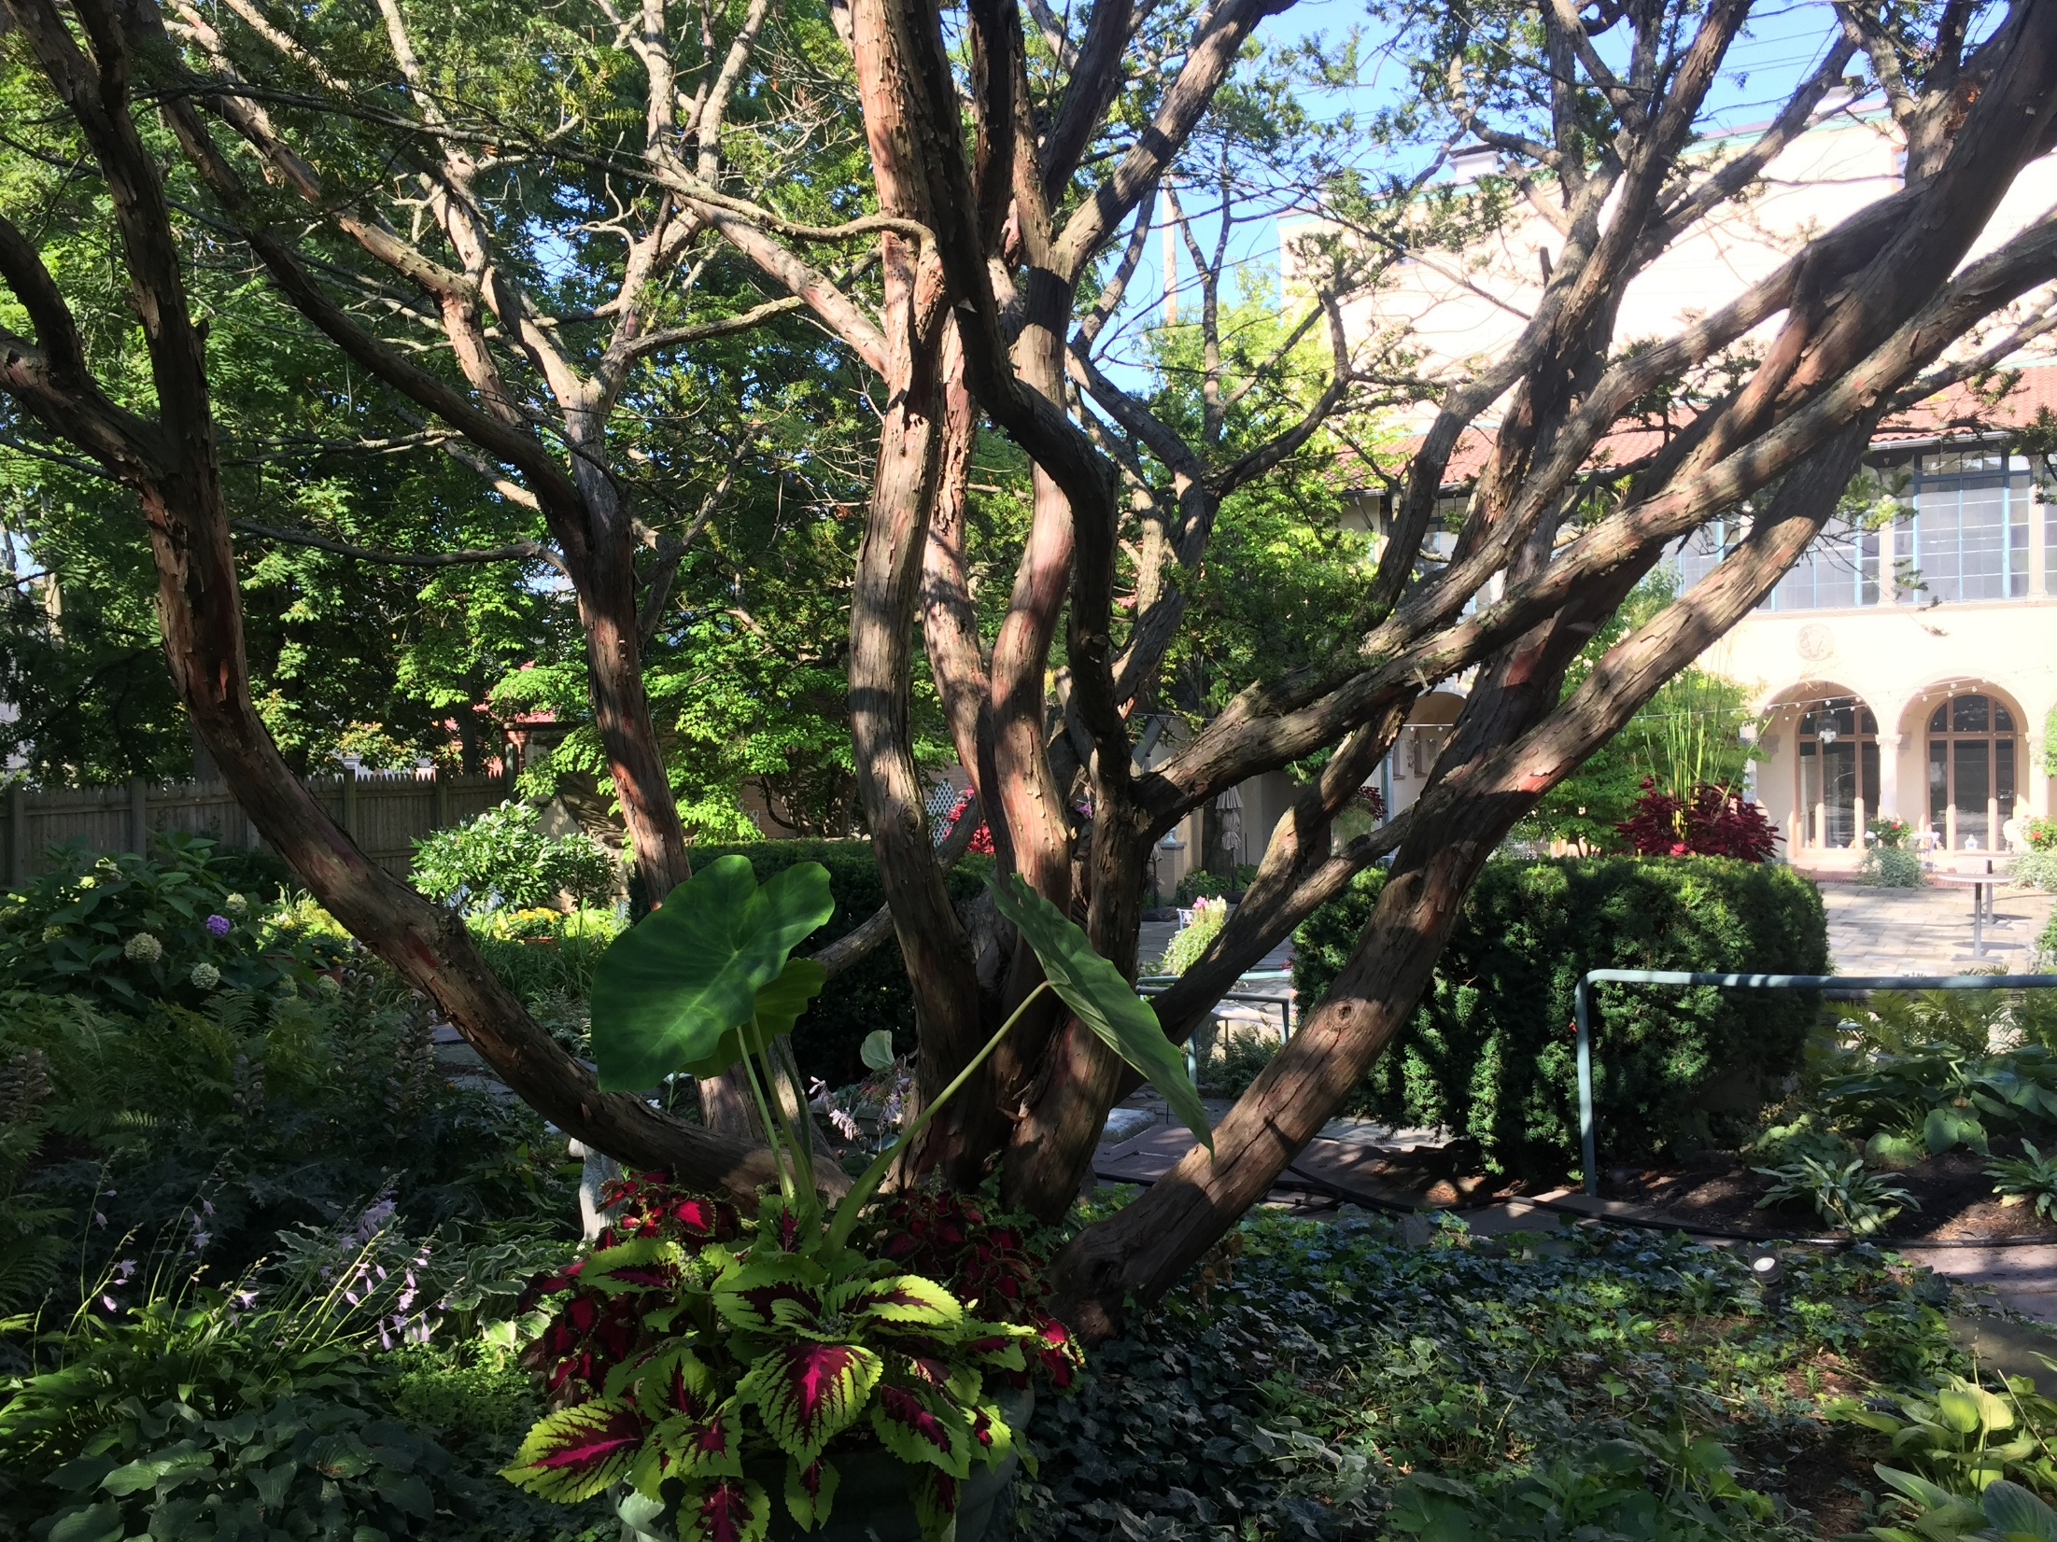

Slide 53
2024-2025 HIGHLIGHTS
WE LAUNCHED OUR NEW WEBSITE!
The Website Committee worked with a strategic marketing agency to create a website that engages members with timely Club information and access to our roster. It is inviting and welcoming to the public interested in learning more about the Club, whether as a prospective member or for hosting an event.
Thank you to Diane Burkholder, Melissa Parrish, Sami Wnek, Janice Worobec and Erin Sullivan for a job well done!

Slide 54
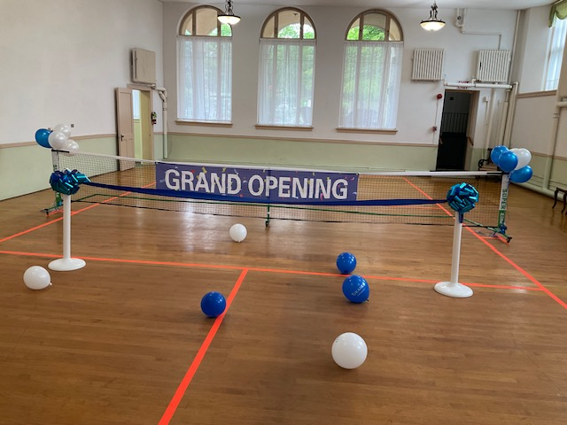
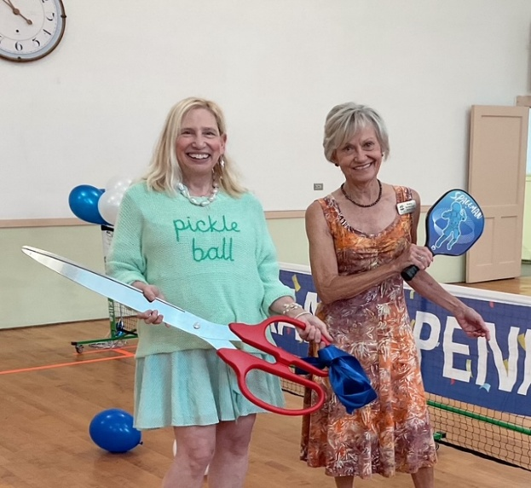
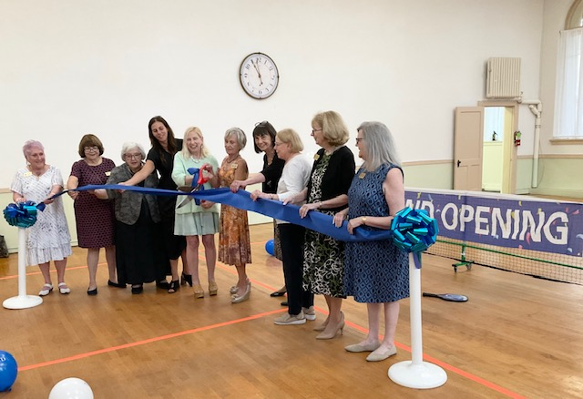
2024 -2025 HIGHLIGHTS
PICKLEBALL!
Ribbon Cutting Ceremony July 10th

Slide 55
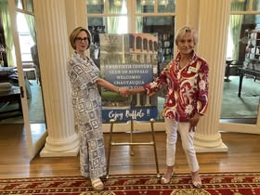
2024 -2025 HIGHLIGHTS
A new reciprocal!
The Chautauqua Women’s Club

Slide 56
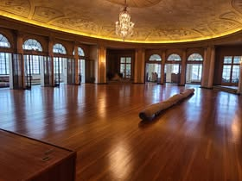
2024 – 2025 HIGHLIGHTS
Refinished floors!

Slide 57
2024-2025 Board of Directors
President – Kathy Schwinger
Planned agendas and conducted all monthly Board Meetings. Created a Board Preparation Presentation and finance summary for Board members. Meeting held on May 17.
Wrote monthly Newsletter articles; proofed emails/Newsletter; contributed Facebook posts
Attended all committee meetings, including Finance, Membership, Personnel, Bylaws, Nominating, Strategic Planning, Dining Room, and several program committee meetings.
Attended evening programs and special events.
In response to members’ concerns, prepared a PowerPoint presentation, and conducted a Special Meeting on September 11 to address the denim issue.
Collaboration was a key aspect of my role – worked closely with the Manager, Bookkeeper, and Finance members to explore new methods of paying dues.
Played a role in determining Holiday Fund disbursements for staff, ensuring fair and thoughtful allocations.
Assisted the Manager in recruiting a new Chef.
Worked alongside the Nominating Chair to replace two Board resignations, ensuring continuity in leadership. Regular collaboration with the Bylaws Chair allowed for thorough consideration and necessary updates to the bylaws.

Slide 58
2024-2025 Board of Directors
President Continued…
Engaged in meetings with the Preservation Foundation regarding drainage solutions and to meet with their tax attorney.
To enhance communication with new and prospective members, updated the Information Packet given to newcomers and rewrote the introductory letter; also crafted a revised letter targeting prospective professional women. Strengthening external connections, I met with the Chautauqua Women’s Club President at the Chautauqua Women’s Club and attended a luncheon for Chautauqua members held at TCC.
Contributions extended to event planning - organized the Christmas Program featuring Mike Randall and Laura Pederson, arranged an evening program with Tom Toles as the speaker, and facilitated a “Mix it Up for Lunch” day to encourage members to interact with different individuals.
Launched the opening of the Pickleball Court, further expanding recreational opportunities for members.
Actively recruited and sponsored several new members. Attended all ‘meet & greets’.
Hosted the Chair Appreciation Luncheon, celebrating the dedication of those who played pivotal roles in the Club.

Slide 59
2024 -2025 Board of Directors
1st Vice President/President Elect - Susan Grelick
Strategic Planning:
The Strategic Planning Committee met, developed key recommendations, and received Board approval to include the following goals in the 2025–2027 Strategic Plan:
  Update the website to enhance functionality.
  Build stronger communication and working relationships with the Preservation Foundation and the Endowment, while exploring other potential funding opportunities.
  Continue evaluating and replacing A/V equipment.
  Change the time frame for implementing an ongoing replacement plan for equipment and furnishings to Spring 2026.
Membership Engagement & Transparency:
  Updated and distributed Interest Sheets to members.
  Created comprehensive Descriptions of Duties and Responsibilities for each Board position and circulated them for review.
Administrative and Financial Enhancements:
  Explored multiple options to improve dues payment, including credit card payments, automatic withdrawals, and yearly billing.
Reciprocity Expansion:
  Formed a Reciprocity Committee, revised related documents, identified target clubs, and finalized outreach letters to expand reciprocal opportunities with other clubs.
Governance:
  Reviewed all governance and procedural documents to ensure they are current and functional.
Collaboration & Planning:
  Participated actively in all Board and Committee meetings.
  Collaborated with other Board members to plan the 2025–2026 calendar and develop the accompanying budget.

Slide 60
2024-2025 Board of Directors
Second Vice President / Bylaws –Kathleen McCarthy
• Committee reviewed the governance documents based on
board/committee input
Presented motions for amendments at the Semi-Annual Meeting
Updated Policies and Procedures
Prepared motions for amendments at the Annual Meeting
Recording Secretary –Mitzie Serafin
• Provided timely and accurate Minutes of all Board and Finance Committee meetings.
• Sent board emails requesting action on various topics, tabulated votes, reported back to the Board.

Slide 61
2024-2025 Board of Directors
Treasurer – Janet Bevilacqua
• • • •
Oversaw all financial accounts and transactions
Documented all financial activities
At Board meetings, reported financial status of the Club Maintained a relationship with TCC’s bank and reviewed
accounts with them periodically
Responsible for signing checks for payments and employee
wages
•
Assistant Treasurer / Holiday Fund –Elizabeth Hulley
• Composed Holiday Employee Fund letter which was sent to members in October
Presented holiday checks with the President to the staff after December 18 Holiday Program

Slide 62
2024-2025 Board of Directors
Personnel – Barb Arnold
The committee met four times during the year
Held informal conversations with Manager on various personnel matters
Adopted policy to perform exit interviews of all key staff that leave voluntarily
Conducted exit interview of Chef Leah
Hired Chef Danielle Carriere
Worked with Assistant Treasurer on Holiday Fund for employees
Engaged Human Relations firm to update Employee Handbook and new-hire documents
Reviewed key staff annual reviews and compensation increases for all staff
Provided insight to the Board of Directors on personnel, compensation, and Club budget

Slide 63
2024-2025 Board of Directors
General Program Chair –Tish Brady
•Worked diligently with Program and Events committees
Updated the members well in advance of all programs and special events
Building and Grounds –Kate Arundell
Purchased new planters for the fountain
Purchased and tended many perennial and annual plants
Overwintered several plants within the club
Currently planning a new garden in place of the Yew Tree
Thanks to support from our Angels we have money for a new tree(s)
Purchased new plants for summer 2025

Slide 64
2024-2025 Board of Directors
Membership – Candy Broman
Spent considerable time speaking with, entertaining, and
following up with prospective members
Guided new members after they have signed in
Contacted members who have not been at the Club recently to
inquire about them and to let them know we miss seeing them Kept continuing member file
Tracked leaves of absence and resignations
•
•
• •
Recording Secretary – Jean Jain
Sent cards and letters: Welcoming new members; Get well and encouragement; Congratulatory, and Resignations and Leaves of Absent acknowledgements

Slide 65
2024-2025 Board of Directors
Dining Room Committee – Melissa Parrish
Met several times throughout the year to plan and review meals for our weekly programs
Focus has been on keeping the menu fresh and fun while staying within budget and being mindful of dietary restrictions among our members.
Introduced a new “dietary plate” option this year, consisting of a plain grilled chicken breast, a starch, and a vegetable
A total of 5,789 meals were served during the 2024–2025 TCC year
– –

Slide 66
2024-2025 Board of Directors
House Furnishings –Megan Forness
Conducted a walkthrough to determine which room would be the focus of improvement efforts. Selected the Gallery Room as our primary project space.
The planned updates include:
  Reupholstering the two couches; refilling the cushions; installing new curtains
Completed one walkthrough with a designer; second appointment scheduled for April 22
Will meet with additional decorators to gather quotes and design ideas, with the goal of selecting options that align with both our vision and budget

Slide 67
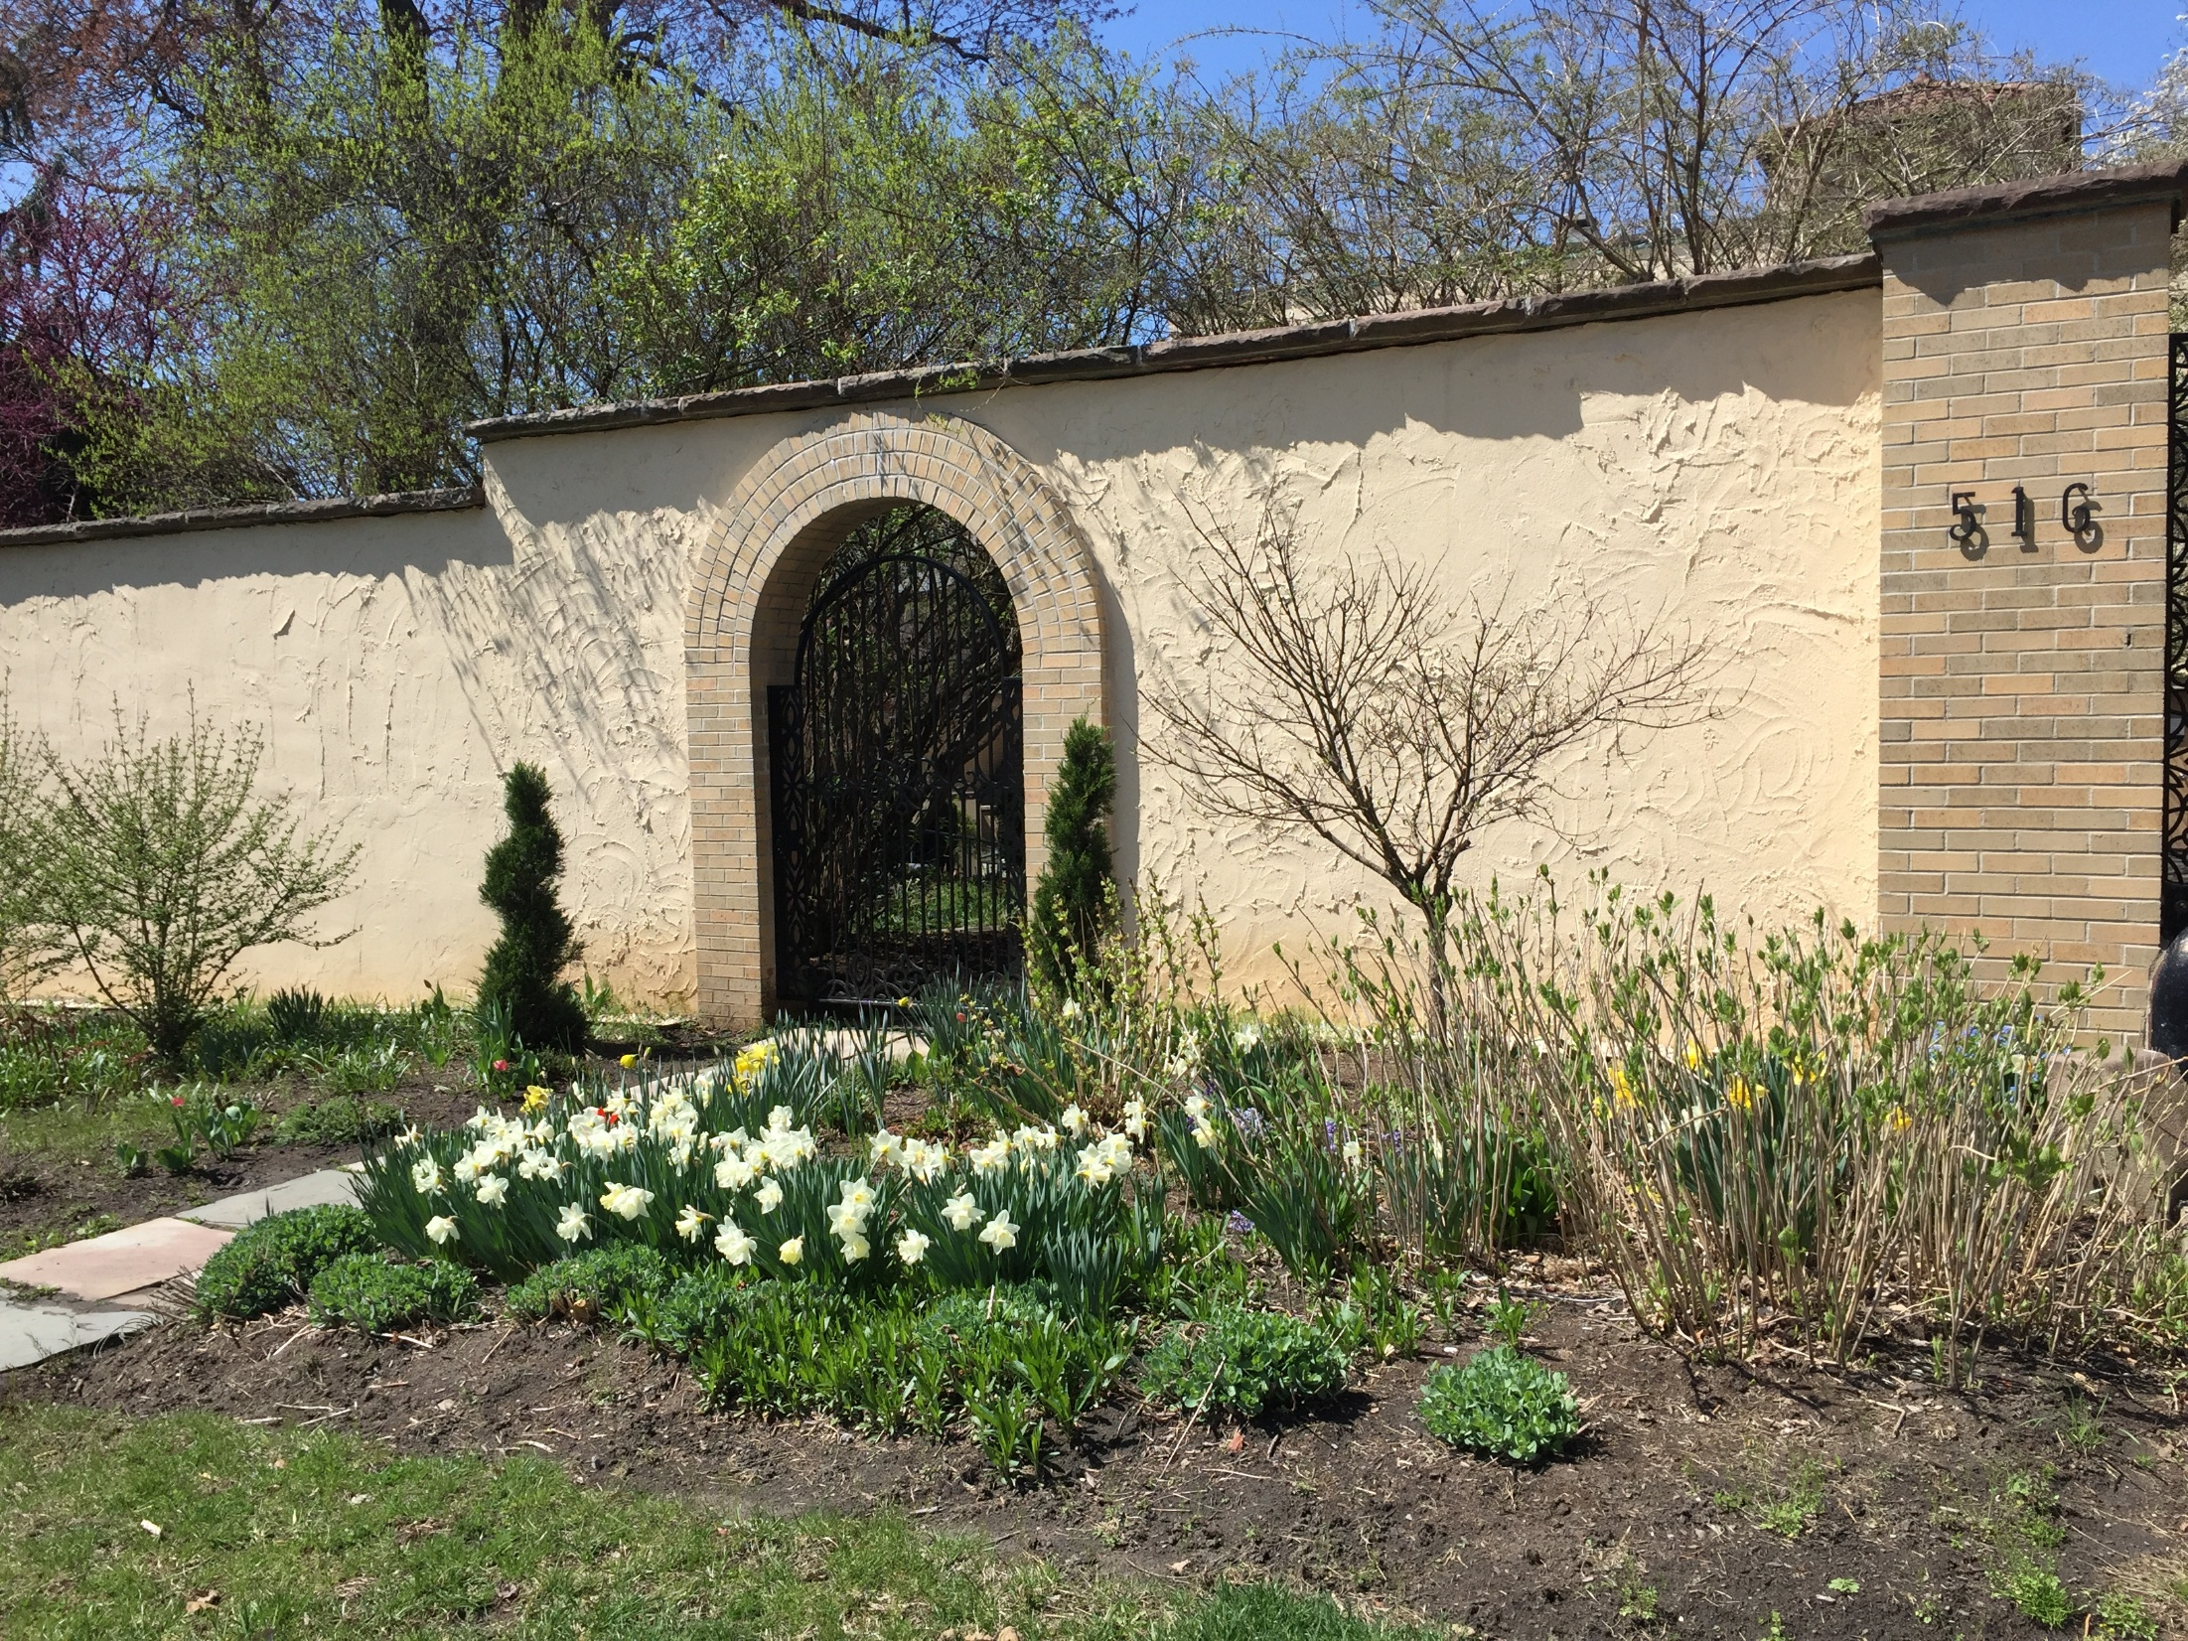

Slide 68
Committee Chairs
  Anything Goes Isabelle Posner
  Archives Dawn Halvorsen
  Birthdays Fay Northrop
  Bridge JoAnn Smith
  Candlelight Dinner Kate Arundell & Diane Sipple
  Charlotte’s Shoppe Janice Worobec
  Coffee Hour Barb Nagowski & Barb Bielecki
  Dining Divas Lisa Faturos
  Docents Chris-Elaine Santilli
  Employee Holiday Fund Elizabeth Hulley
  Endowment Memorial Fund Lee Grunert
  Evening Book Club Janice Worobec

Slide 69
Committee Chairs
  Evening Speaker Kathleen Schwinger
  Fashion Show Diane Slawinowski & Megan Leith
  Garden Kate Arundell
  Golf Kathleen Schwinger
  Greeters Barb Utter & Cynthia Raven
  Historian Kathryn Homer
  Holiday Décor Linda Gianturco, Karen DiVito
  & Dianne Sippel
  Holiday Tea Martha Rasmussen & Isabelle Posner
  Holiday Program Kathy Schwinger
  Hostesses / Speaker’s Table Diane Chrisman

Slide 70
Committee Chairs
  Insurance Lisa Faturos
  Lavender & Lace Barb Burwick & Liz Krawczyk
  Library Anne Slater
  Memorial Endowment Fund Lee Grunert
  Mexican Train Dru Hites & Soledad Proano
  Mother’s Day Brunch Martha Rasmussen & Liz Krawczyk
  New Member Orientation Kathryn Homer
  Parliamentarian Roz Annunziato
  Past Presidents Kathryn Homer
  Photographer Melissa Parrish
  President’s Ball Diane Sippel
  Presidents’ Day Sami Wnek

Slide 71
Committee Chairs
  Sip & Shop Megan Leith & Diane Slawinowski
  St. Patrick’s Day Brunch Norine Dunnigan & Barb Bielecki
  Strategic Plan Susan Grelick
  Summer Programs Lynn Lowrey & Jane Hartney
  Tree Lighting Barbara Burwick
  Trips & Tours Mary Lou Mancuso
  Tuesday Evenings Diane Slawinowski & Megan Leith
  Valentine’s Dinner Emily Schaefer
Our members are truly exceptional!
Your willingness and enthusiasm in taking on numerous duties and events is commendable. We extend our deepest thanks and heartfelt appreciation for your invaluable contributions.

Slide 72
Staff
  General Manager – Erin Sullivan
  Dining Room Manager – Mary Jo Crowe
  Executive Chef – Danielle Carriere
  Office Manager – Briana Paterson
  Maintenance Supervisor - Ryan America
  Our sincere appreciation to all the above,
  as well as the many more, who are dedicated,
  considerate and caring.
  Thank you!

Slide 73
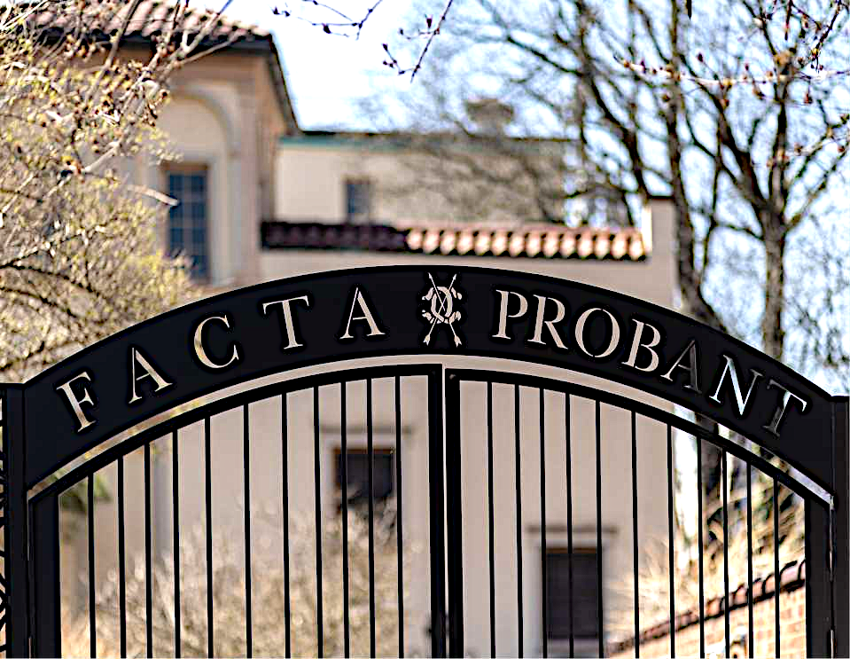
Adjourn
The Annual Report will be emailed.
Printed double-sided copies are available upon request to the Office.
Reports will not be mailed.
There being no further business to come before this meeting, the
131st Annual meeting is adjourned.eeting is adjourned.
Thank you !

